Slide 1
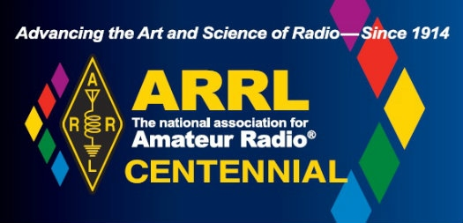

Slide 2
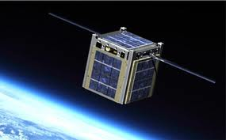
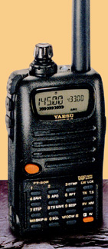
Introduction To Amateur Satellites
Peter Portanova, W2JV – AMSAT Area Coordinator
Patrick Stoddard, WD9EWK/VA7EWK – AMSAT
Area Coordinator and Director of Field Operations
Notes:
Title Page: DISCUSS YOUR QUALIFICATIONS

Slide 3
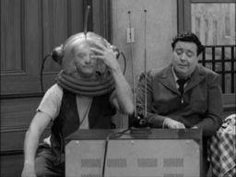
CAPTAIN VIDEO- I AM READY TO BLAST OFF

Slide 4
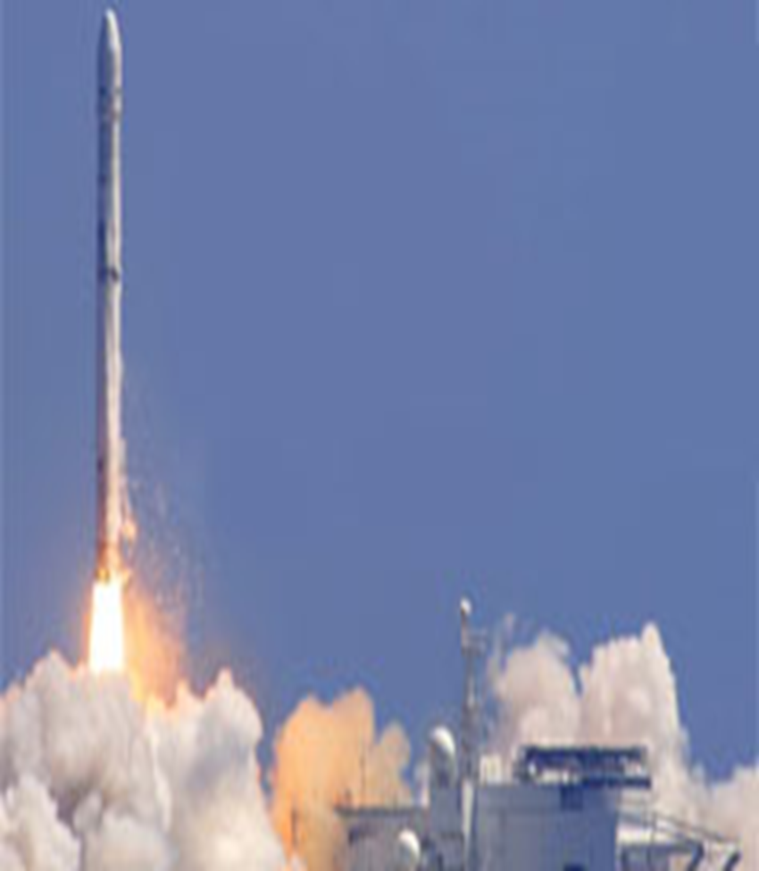
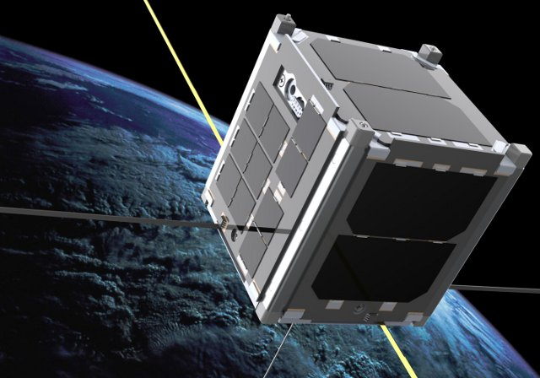

Slide 5
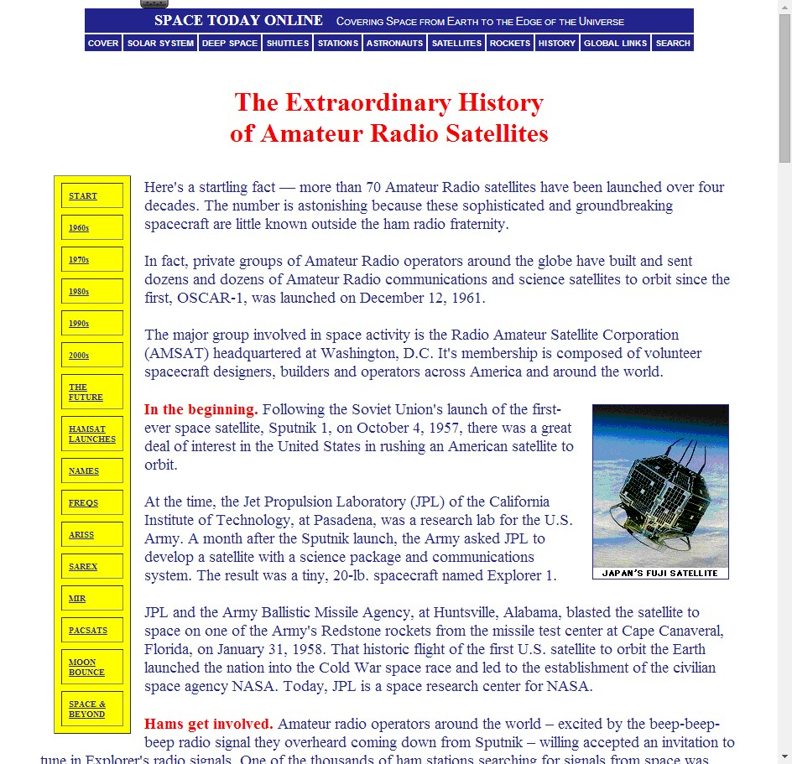

Slide 6
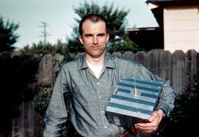
Lance Ginner- K6GSJ

Slide 7
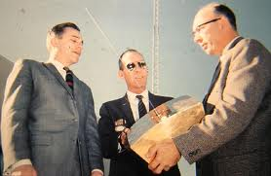

Slide 8
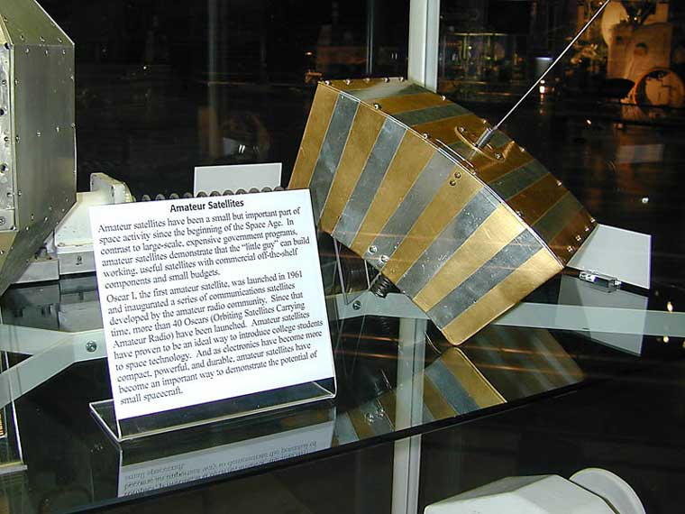
OSCAR 1
o

Slide 9
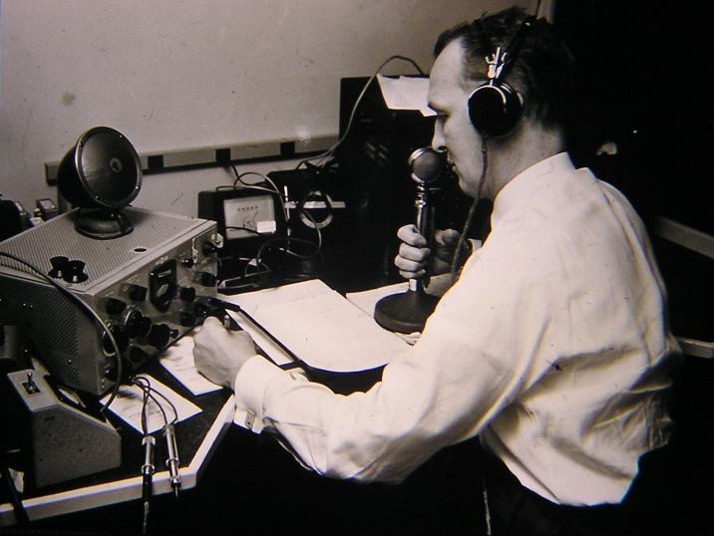

Slide 10
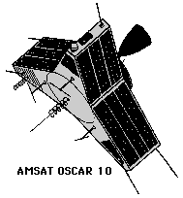

Slide 11
WWW.AMSAT.ORG

Slide 12
What is an Amateur Satellite?

Slide 14
Satellite Myths Busted at ARRL Centennial

Slide 15
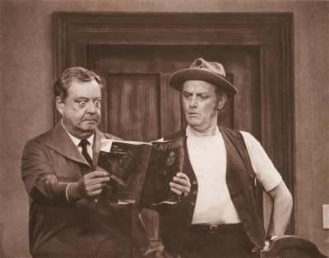

Slide 17
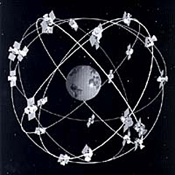
OSCBIL
Low Noise Block Downconverter
OSCAR
Bent Pipe Transponder
Clarke Belt
Notes:
ORBITING SATELLITE CARRYING AMATEUR RADIOS

Slide 18
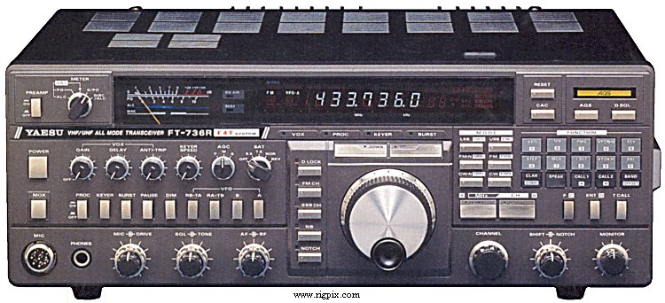
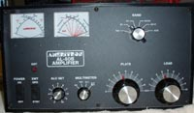
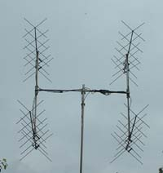
Notes:
DON’T NEED POWER OR BIG ANTENNAS

Slide 19
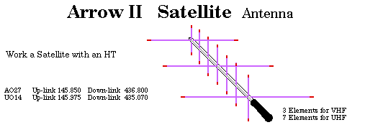
Typical Equipment Used in FM/TX Satellite Ops
2-FT-50R’s
Dual-band, 2 VFOs
Split-frequencies
ADVANTAGES OF USING 2 HT’S
DIGITAL RECORDER, COMPASS,

Slide 20
Radios etc.
Transmit:
Dual-Band Radio- Program Split Freq.
Including- Yaesu-Kenwood- Baofeng- Wouxun
Receive:
Scanners- Capable of RX- VHF-UHF
Dongles- FUNcube, RTL-SDR

Slide 21
ANTENNAS
½ to ¼ Wave ground-plane
¼ - 5/8 WAVE VERTICALS
“EGGBEATER” OMNIDIRECTIONAL
Discone
Hand Held Yagi (or other directional antenna)

Slide 22
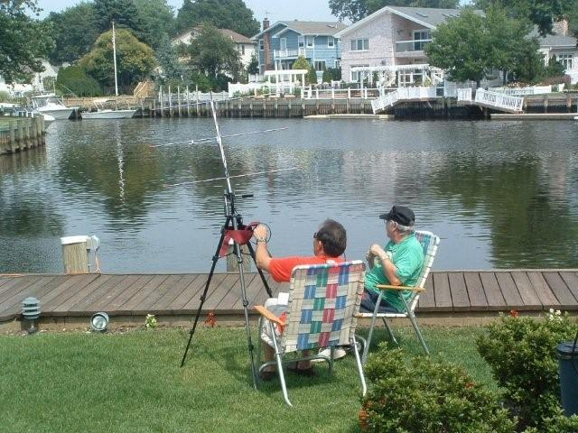
PLAN FOR SUCCESS
PREPARING FOR A SATELLITE PASS

Slide 23
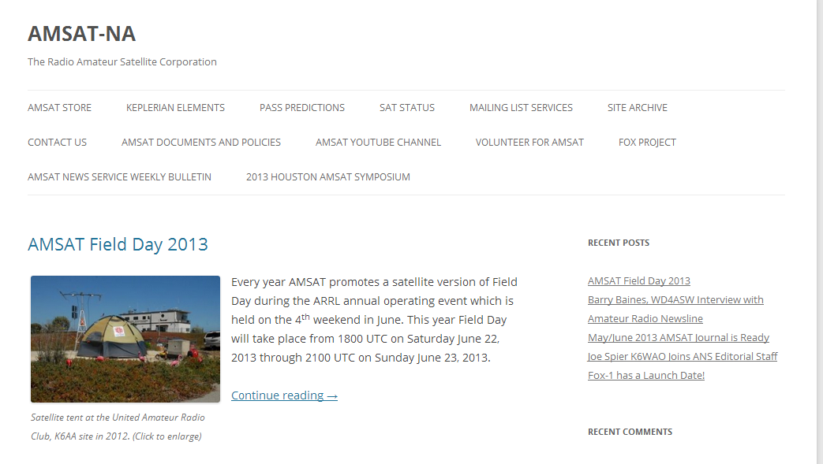
WWW.AMSAT.ORG

Slide 24
SO-50

Slide 25
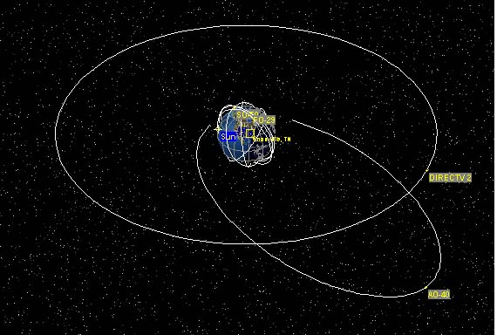
Satellite Orbits
Geostationary
HEO (High Earth Orbit)
LEO (Low Earth Orbit)
S0-50, APOGEE 713KM, PERIGEE, 603KM
Notes:
A sun-synchronous orbit (sometimes incorrectly called a heliosynchronous orbit) is a geocentric orbit which combines altitude and inclination in such a way that an object on that orbit ascends or descends over any given point of the Earth's surface at the same local mean solar time. The surface illumination angle will be nearly the same every time. This consistent lighting is a useful characteristic for satellites that image the Earth's surface in visible or infrared wavelengths (e.g. weather and spy satellites) and for other r

Slide 26
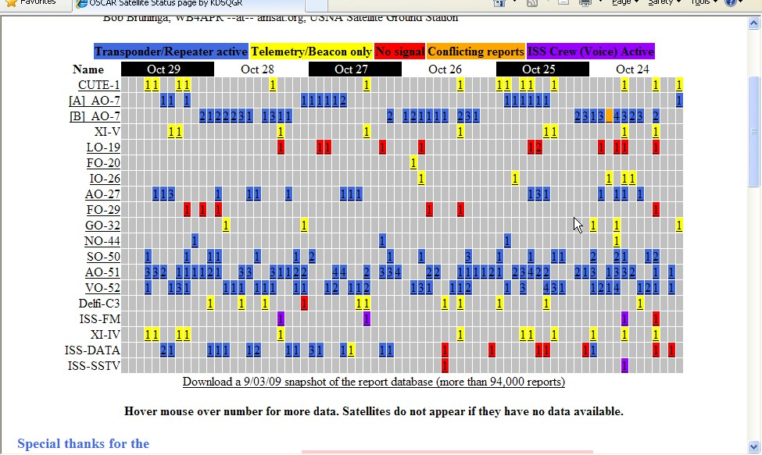
When are the satellites available?
http://oscar.dcarr.org/

Slide 27
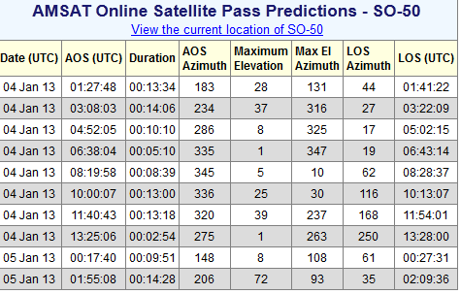
Notes:
AMSAT PASS PREDICTION RESULTS

Slide 28
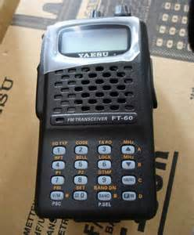
PROGRAMMING RADIOS
TX
RX
Notes:
AMSAT PASS PREDICTION RESULTS

Slide 29
ADJUSTING FOR DOPPLER
CH # | NAME | TX FREQ | CTCSS (TX) | RX FREQ
101 | SO50 ON | 145.850 | 74.4 | 436.810
102 | SO50-1 | 145.850 | 67.0 | 436.810
103 | SO50-2 | 145.850 | 67.0 | 436.805
104 | SO50-3 | 145.850 | 67.0 | 436.800
105 | SO50-4 | 145.850 | 67.0 | 436.795- dlink
106 | SO50-5 | 145.850 | 67.0 | 436.790
107 | SO50-6 | 145.850 | 67.0 | 436.785

Slide 30
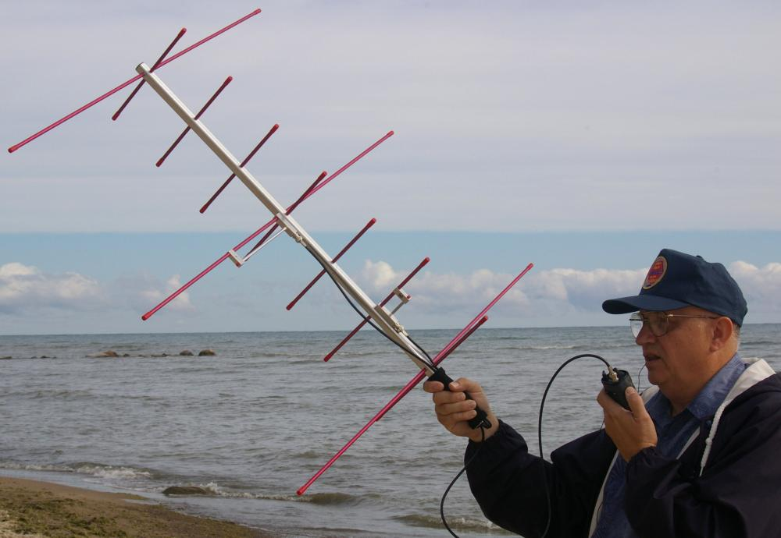
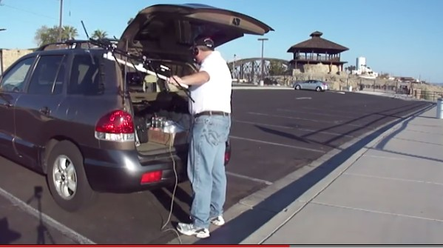
ARROW OR ELK ANTENNAS

Slide 31
DOPPLER EFFECT ON SATELLITES

Slide 32
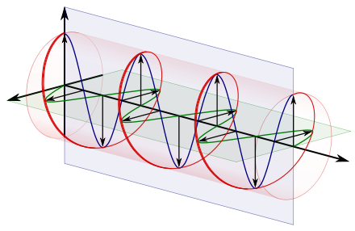
FARADAY EFFECT ON SATELLITES
http://youtu.be/XTqjQ9xIQQE

Slide 33
Prepare for A Successful SO-50 Pass
Go to WWW.AMSAT.ORG
“Passes” top menu- 30 degrees minimum when starting out
Show predictions for SO-50
Add Grid Square- FN31 for the ARRL Centennial Convention
RADIO- SPLIT FREQUENCIES
Squelch Open
WATCH- UTC
COMPASS
DIGITAL RECORDER
Grid Square
Predict
Set your watch
Compass to trace path
Check watch
Set radio for downlink- Uplink
Listen for quieting
Squelch open
Doppler shifts fast
Notes:
Successful sat QSO flow chart

Slide 34
Making Contacts
Listen to the satellite, pick out some callsigns
Give your call-/ handheld
Call a specific station, or just transmit your callsign - DO NOT CALL CQ!
Contacts are usually quick - callsign, location, maybe your name (similar to HF contests or DXpeditions)
Regular operators can recognize new operators, and are happy to make contacts and help with operating advice
Satellite operators like to exchange “grids” for awards
Notes:
Making contacts

Slide 35
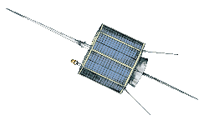
Satellite Contact
ao51.112410.flv
5:56

Slide 36
WHAT WENT WRONG?
FORGOT OUR GLASSES
WATCH NOT SYNCHRONIZED
INCORRECT LATITUDE, LONGITUDE
NOT ON THE CORRECT PATH OF SATELLITE
ANTENNA
UPLINK, DOWNLINK FREQUENCIES OFF
NOT TUNING FAST ENOUGH
SATELLITE PASS TOO LOW
SQUELCH IS MUTED
XYL IS YELLING- “THE NEIGHBORS ARE LOOKING”
MEET LAW ENFORCEMENT, UP CLOSE & PERSONAL

Slide 37
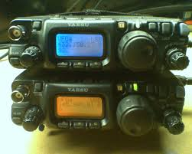
Expand your Horizons
Linear Satellites- SSB/CW

Slide 38
SSB/CW via satellite
Some differences…
Instead of one channel, transponders with 20 to 100 kHz – like a small HF band!
Transponders support multiple QSOs
Must deal with Doppler on both uplink and downlink
Computer control of radio(s) preferred by many, but manual control is possible – using “One True Rule”
Manually adjust higher of the two frequencies, to deal with Doppler

Slide 39
SSB/CW via satellite
Two satellite-ready transceivers in production:
Icom IC-9100
Kenwood TS-2000
Many older satellite-ready transceivers on resale
market still used by satellite operators….
Icom IC-910, IC-821, IC-820
Kenwood TS-790
Yaesu FT-847, FT-736, FT-726
FlexRadio FLEX-5000 with VHF/UHF module

Slide 40
SSB/CW via satellite
Some use separate radios for transmit and receive…
HF/VHF/UHF transceiver for transmit:
Icom IC-706Mk2/Mk2G, IC-7000, IC-7100
Yaesu FT-817, FT-857, FT-897, FT-100
or monoband all-mode transceiver
Many options for receive:
Another HF/VHF/UHF transceiver for receive
Wide-band, all-mode receiver
Kenwood TH-F6A HT (all-mode RX up to 470 MHz)
SDR receiver/dongle

Slide 41
SSB/CW via satellite
With our current satellites in lower orbits, even 5W from FT-817s can be adequate for working these satellites. Lower power levels are recommended, as not to overpower these transponders.
Two FT-817s, or an FT-817 with a portable all-mode receiver (or TH-F6A), and an antenna like a dual-band Yagi or log periodic, can make a small and very portable all-mode satellite station.

Slide 42
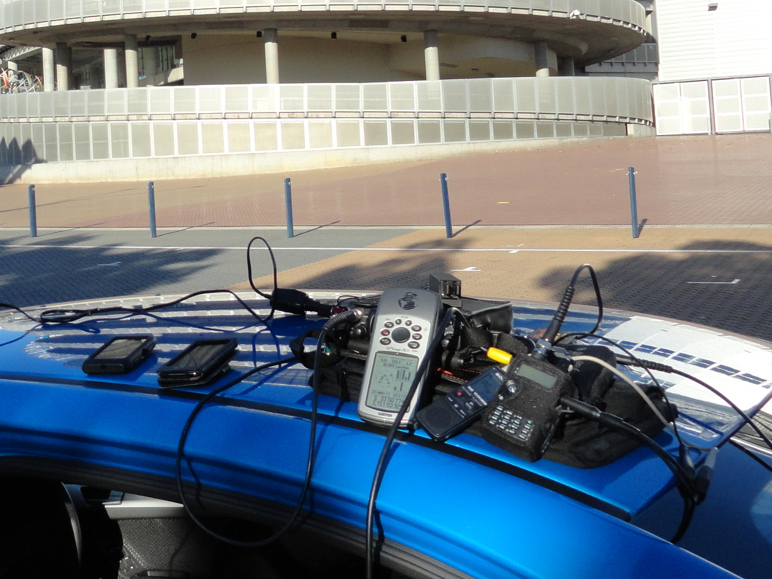
SSB/CW via satellite
FT-817ND/TH-F6A combo on rental car (with Elk log periodic, not in view). Where is this??

Slide 43
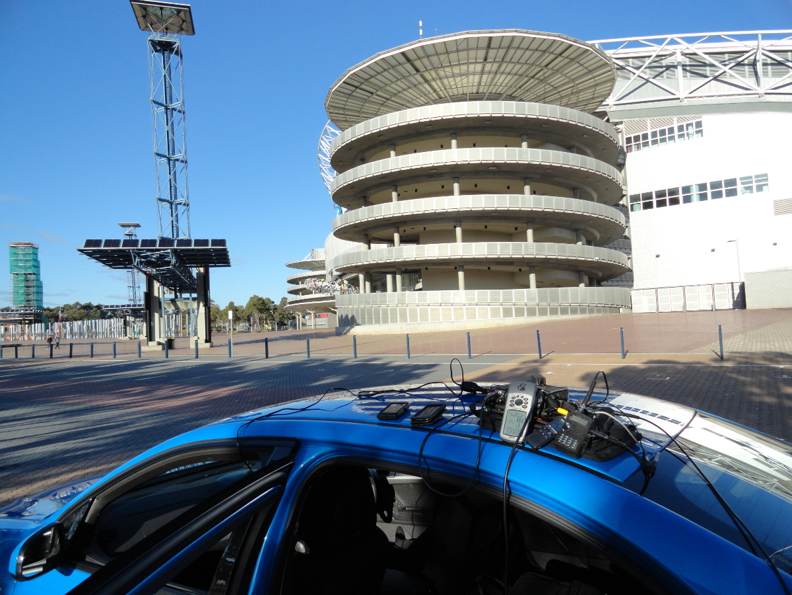
SSB/CW via satellite
VK/WD9EWK, parked next to Olympic stadium in Sydney (Australia) Olympic Park - 28 May 2011

Slide 44
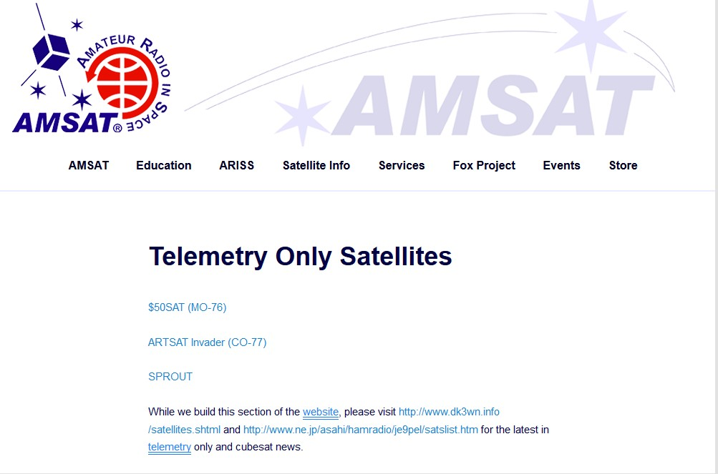

Slide 45
Telemetry
Available in many formats
CW
RTTY
AX.25 packet
FSK, BPSK, and other digital protocols
Even OSCAR I sent telemetry
CW speed keyed to satellite temperature
Some satellites send telemetry in multiple formats

Slide 46
Telemetry
Provides information on health of satellite’s systems
Examples of telemetry from different satellites…
AO-27 used 1200bps AX.25 packet
HO-68 uses CW
$50Sat uses CW and RTTY
ARISSat-1 used, and FUNcube satellites use, BPSK
Fox-1 will use FSK simultaneously w/FM downlink
Copying telemetry – another great way to evaluate performance of stations used for satellite operating

Slide 47
Telemetry
ARISSat-1 software

Slide 48
Telemetry
FUNcube-1 Dashboard

Slide 49
Telemetry
Some software only needs audio from a receiver to decode telemetry, where other software can even control the receiver to decode the telemetry.
Once decoded, telemetry can be sent to satellite maintainers, or the software can upload it in real time to a central server.

Slide 50
Telemetry
Telemetry from ARISSat-1 web site
http://www.arissattlm.org/live

Slide 51
Telemetry
Telemetry from FUNcube-1 data warehouse web site
http://warehouse.funcube.org.uk/

Slide 52
Telemetry
Stations capable of working satellites can be used to copy satellite telemetry. Some will set up separate stations for receiving telemetry with a simpler combination of radio and antenna. For example, antennas….

Slide 53
Telemetry
W2BFJ’s antennas: 70cm AA2TX Lindenblad on left,
2m Eggbeater on right, both omnidirectional

Slide 54
Telemetry
WD9EWK’s 2m turnstile on mast/tripod, laptop with FUNcube Dongle & Dashboard software in yard

Slide 55
Telemetry
SDR dongles are very popular for copying telemetry, thanks in large part to FUNcube Dongles and availability of inexpensive DVB TV dongles that can act as wide-band receiver for other signals. Depending on the type of telemetry downlink, other receivers and scanners are useful for copying telemetry.

Slide 56
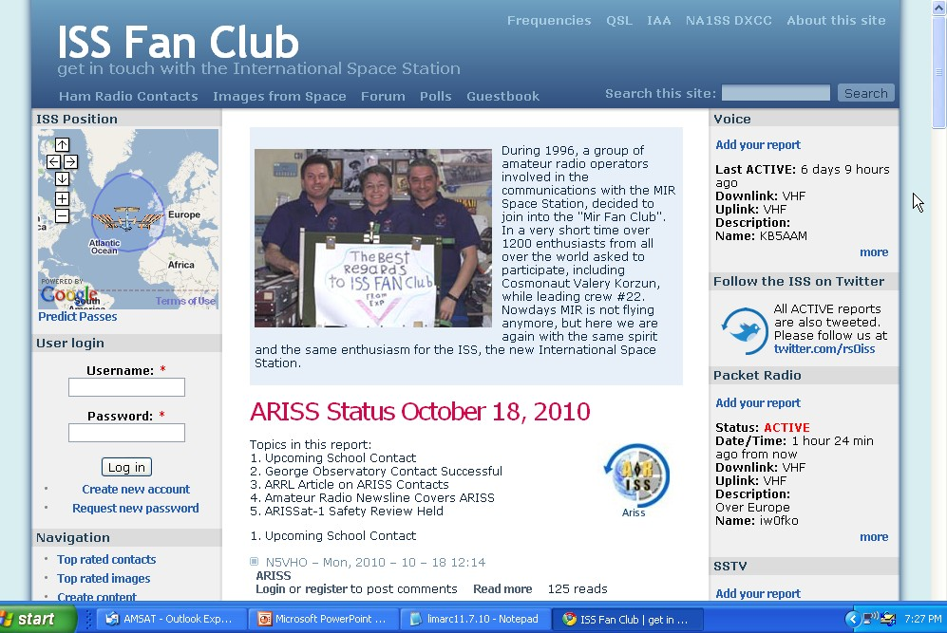
http://www.issfanclub.com

Slide 57
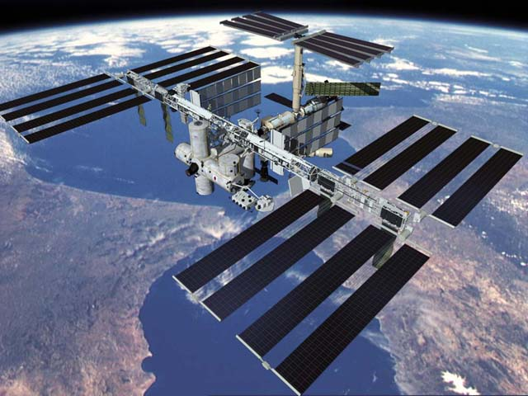
ISS Contact- Col. Doug Wheelock
Notes:
VIDEO

Slide 58
Amateur Satellite Resources
www.amsat.org
ARRL
www.starcommgroup.org

Slide 59
Satellite Tracking Software
iPhone- Satellite Tracker
Android- FREE AMSAT Droid
Web- Orbitron.com
Heavens-Above.com
N2YO.com
www.amsat.org
SatPC32

Slide 60
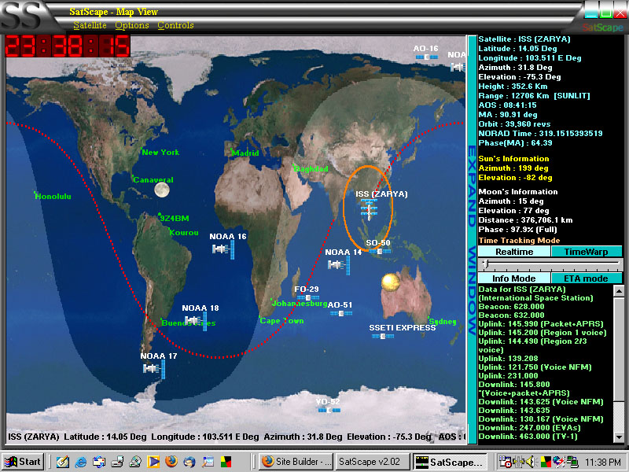
SATSCAPE

Slide 61
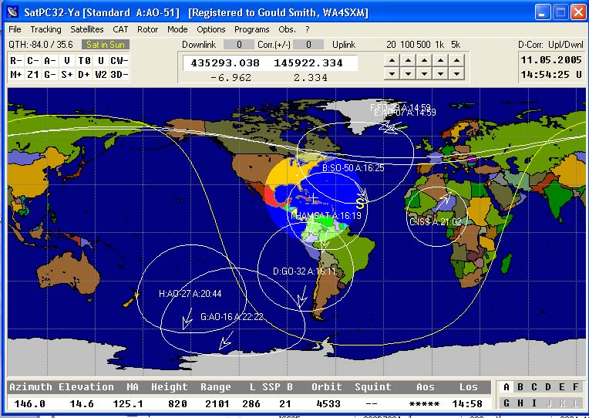
SatPC32 software
Will also do antenna and radio control
Notes:
The circles are Footprints, the area covered by the satellite.

Slide 62
Nova
Notes:
This is screen shot of NOVA’s Earth View with multiple sats and orbits
NOVA for Windows (Northern Lights Software Associates)
NOVA is available from AMSAT .. At their new AMSAT.ORG Store.

Slide 63
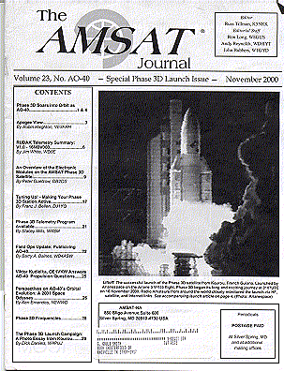
Periodicals

Slide 64
How do we keep Amateur Radio in Space?

Slide 65
Background
AO-51 was the most popular ham satellite
Could be worked with simple equipment - HT and a hand held antenna
Widely used in recruiting, scouting, educational and demonstration events
Failed in November 2011

Slide 66
A New Reality
P3E to GTO - $10M
Small Sat to LEO - $3M
ARISSat to ISS - $1M
MicroSat to LEO - $500K
1U CubeSat to LEO - $100K

Slide 68
More Satellites on the way
FUNcube-1
Delfi-n3Xt
Ukube-1
Triton-1
Triton-2
Fox-1
RadFXSat

Slide 69
Get started right now! WWW.AMSAT.ORG AMSAT-BB The new AMSAT Web Site has it all! Join AMSAT Buy Getting Started books Use Satellite positioning tools online Easy Satellite status & Frequency charts
Notes:
I recommend leaving this slide up during the Q & A Period, there are a few slides after this one that you can use to answer questions but try to come back to this slide and leave it up on the screen for as long as possible. Let this slide be the action to take next!

Slide 70
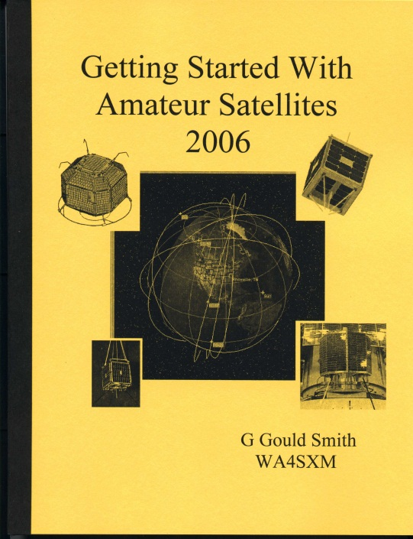
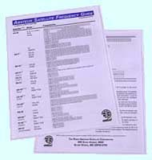
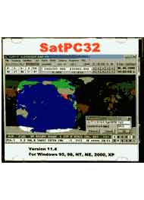
Books for Specific Satellite Types
Satellite frequency guide
Getting started
SatPC32
Notes:
THIS IS THE CUSTER END This is the slide I leave on the screen during questions….
I have a copy of Gould’s two newest books… the getting started and also the AO-51 book and I let them circulate during the question and demo period. (I always get them back too!)

Slide 72
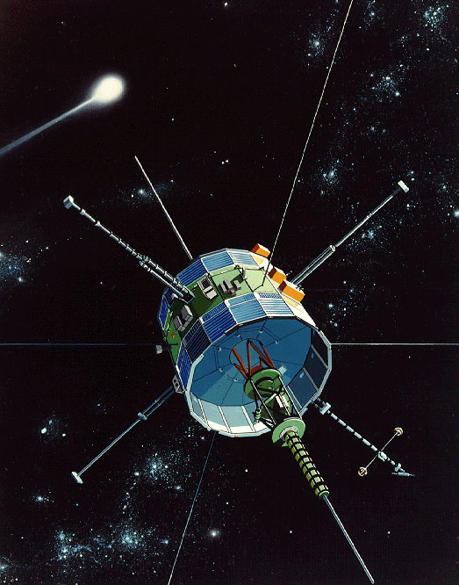
Questions?
Notes:
Questions

