Slide 1
Orbital Mechanics
Joe Spier, K6WAO – AMSAT Director for Education
ARRL 100th Centennial Educational Forum

Slide 2
History
Astrology
Pseudoscience based on several systems of divination based on the premise that there is a relationship between astronomical phenomena and events in the human world.
Many cultures have attached importance to astronomical events, and the Indians, Chinese, and Mayans developed elaborate systems for predicting terrestrial events from celestial observations.
In the West, astrology most often consists of a system of horoscopes purporting to explain aspects of a person's personality and predict future events in their life based on the positions of the sun, moon, and other celestial objects at the time of their birth.
The majority of professional astrologers rely on such systems.

Slide 3
History
Astronomy
Astronomy is a natural science which is the study of celestial objects (such as stars, galaxies, planets, moons, and nebulae), the physics, chemistry, and evolution of such objects, and phenomena that originate outside the atmosphere of Earth, including supernovae explosions, gamma ray bursts, and cosmic microwave background radiation.
Astronomy is one of the oldest sciences.
Prehistoric cultures have left astronomical artifacts such as the Egyptian monuments and Nubian monuments, and early civilizations such as the Babylonians, Greeks, Chinese, Indians, Iranians and Maya performed methodical observations of the night sky.
The invention of the telescope was required before astronomy was able to develop into a modern science.
Historically, astronomy has included disciplines as diverse as astrometry, celestial navigation, observational astronomy and the making of calendars, but professional astronomy is nowadays often considered to be synonymous with astrophysics.

Slide 4
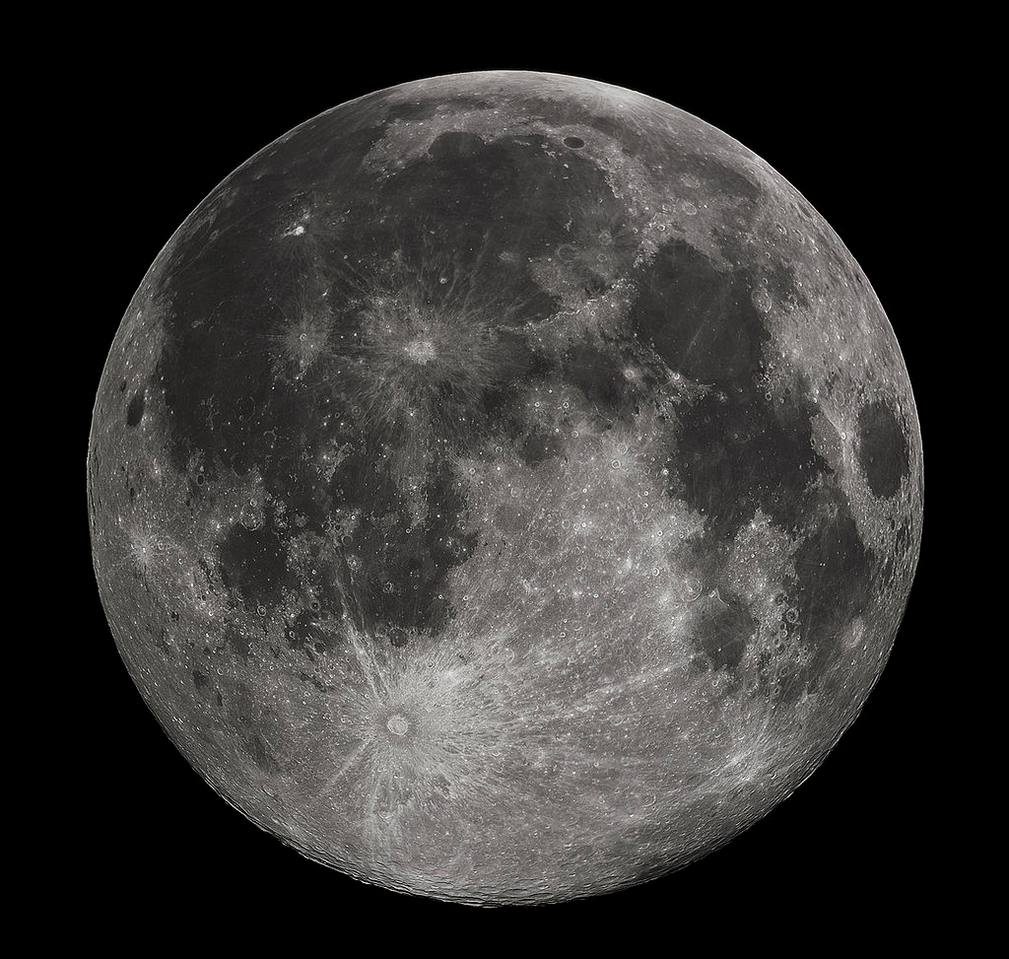
History
Lunar and Planetary Motions
Phases of the Moon to determine calendar
The four principal lunar phases are first quarter, full moon, third quarter, and new moon (third quarter moon is also known as last quarter moon.) Each of the four lunar phases is roughly 7 days (~7.4 days) each, but varies slightly due to lunar apogee and perigee.
The average calendrical month, which is 1⁄12 of a year, is about 30.44 days, while the Moon's phase (synodic) cycle repeats on average every 29.53 days.
“Morning and Evening” Stars
Stars that transit into morning or evening, i.e. Mercury, Venus, Mars, Jupiter, Saturn
The Greek name for Venus is Aphrodite

Slide 5
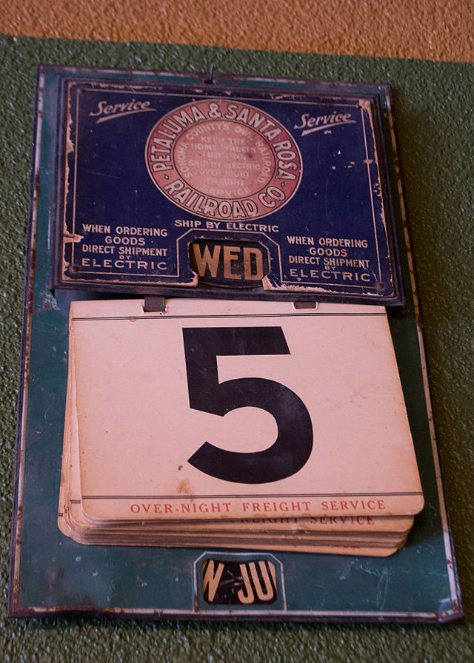
History
Solstices & Equinoxes
Summer and Winter Solstice – Longest and Shortest Daylight
Vernal and Autumnal Equinox – Equal Day/Night – planting and harvest seasons
Solar calendar
The Gregorian calendar, also called the Western calendar and the Christian calendar, is internationally the most widely used civil calendar. It has been the unofficial global standard for decades, recognized by international institutions such as the United Nations and the Universal Postal Union.
In addition to the change in the mean length of the calendar year from 365.25 days (365 days 6 hours) to 365.2425 days (365 days 5 hours 49 minutes 12 seconds), a reduction of 10 minutes 48 seconds per year, the Gregorian calendar reform also dealt with the accumulated difference between these lengths.
The calendar was a refinement in 1582 to the Julian calendar amounting to a 0.002% correction in the length of the year. The motivation for the reform was to bring the date for the celebration of Easter to the time of the year in which the First Council of Nicaea had agreed upon in 325. Because the celebration of Easter was tied to the spring equinox, the Roman Catholic Church considered this steady drift in the date of Easter undesirable. The reform was adopted initially by the Catholic countries of Europe. Protestants and Eastern Orthodox countries continued to use the traditional Julian calendar and adopted the Gregorian reform after a time, for the sake of convenience in international trade. The last European country to adopt the reform was Greece, in 1923.

Slide 6
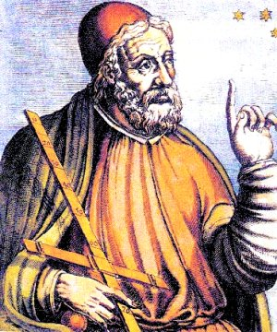
Ptolomy
Claudius Ptolemy, (c. AD 90 – c. AD 168) was a Greco-Egyptian writer of Alexandria, known as a mathematician, astronomer, geographer, astrologer, and poet of a single epigram in the Greek Anthology. He lived in the city of Alexandria in the Roman province of Egypt, wrote in Greek, and held Roman citizenship.
The name Claudius is a Roman nomen; the fact that Ptolemy bore it indicates he lived under the Roman rule of Egypt with the privileges and political rights of Roman citizenship. It would have suited custom if the first of Ptolemy's family to become a citizen (whether he or an ancestor) took the nomen from a Roman called Claudius who was responsible for granting citizenship. If, as was common, this was the emperor, citizenship would have been granted between AD 41 and 68 (when Claudius, and then Nero, were emperors).
The Almagest is the only surviving comprehensive ancient treatise on astronomy. Babylonian astronomers had developed arithmetical techniques for calculating astronomical phenomena; Greek astronomers such as Hipparchus had produced geometric models for calculating celestial motions. Ptolemy, however, claimed to have derived his geometrical models from selected astronomical observations by his predecessors spanning more than 800 years, though astronomers have for centuries suspected that his models' parameters were adopted independently of observations.
Ptolemy presented his astronomical models in convenient tables, which could be used to compute the future or past position of the planets. The Almagest also contains a star catalogue, which is a version of a catalogue created by Hipparchus. Its list of forty-eight constellations is ancestral to the modern system of constellations, but unlike the modern system they did not cover the whole sky (only the sky Hipparchus could see). Through the Middle Ages, it was the authoritative text on astronomy, with its author becoming an almost mythical figure, called Ptolemy, King of Alexandria.

Slide 7
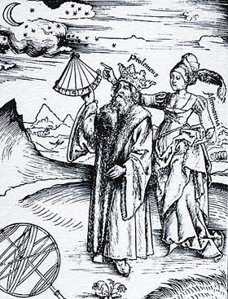
Ptolomy
The Almagest was preserved, like most of Classical Greek science, in Arabic manuscripts (hence its familiar name). Because of its reputation, it was widely sought and was translated twice into Latin in the 12th century, once in Sicily and again in Spain.
Ptolemy's model, like those of his predecessors, was geocentric and was almost universally accepted until the appearance of simpler heliocentric models during the scientific revolution.
His Planetary Hypotheses went beyond the mathematical model of the Almagest to present a physical realization of the universe as a set of nested spheres, in which he used the epicycles of his planetary model to compute the dimensions of the universe. He estimated the Sun was at an average distance of 1,210 Earth radii, while the radius of the sphere of the fixed stars was 20,000 times the radius of the Earth.
Ptolemy presented a useful tool for astronomical calculations in his Handy Tables, which tabulated all the data needed to compute the positions of the Sun, Moon and planets, the rising and setting of the stars, and eclipses of the Sun and Moon.
Ptolemy's Handy Tables provided the model for later astronomical tables or zījes. In the Phaseis (Risings of the Fixed Stars), Ptolemy gave a parapegma, a star calendar or almanac, based on the hands and disappearances of stars over the course of the solar year.

Slide 8
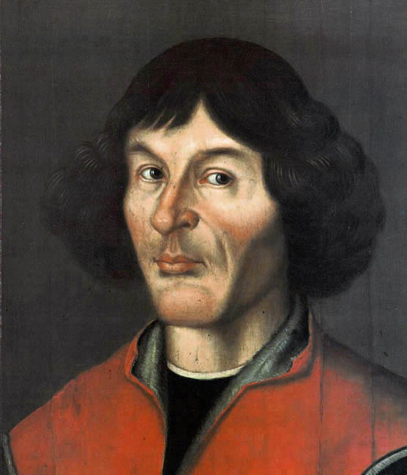
Nicolas Copernicus
Nicolaus Copernicus (19 February 1473 – 24 May 1543) was a Renaissance mathematician and astronomer who formulated a heliocentric model of the universe which placed the Sun, rather than the Earth, at the center.
The publication of Copernicus' book, De revolutionibus orbium coelestium (On the Revolutions of the Celestial Spheres), just before his death in 1543, is considered a major event in the history of science. It began the Copernican Revolution and contributed importantly to the scientific revolution.
Despite the near universal acceptance today of the basic heliocentric idea (though not the epicycles or the circular orbits), Copernicus' theory was originally slow to catch on. Scholars hold that sixty years after the publication of The Revolutions there were only around 15 astronomers espousing Copernicanism in all of Europe: "Thomas Digges and Thomas Harriot in England; Giordano Bruno and Galileo Galilei in Italy; Diego Zuniga in Spain; Simon Stevin in the Low Countries; and in Germany, the largest group – Georg Joachim Rheticus, Michael Maestlin, Christoph Rothmann (who may have later recanted),and Johannes Kepler.“ Additional possibilities are Englishman William Gilbert, along with Achilles Gasser, Georg Vogelin, Valentin Otto, and Tiedemann Giese.

Slide 9
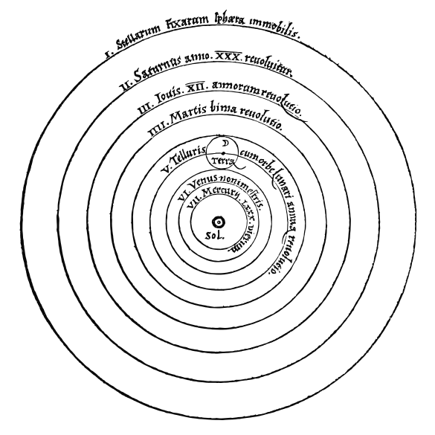
Nicolas Copernicus
Nicolas Copernicus - De revolutionibus orbium coelestium
1. There is no one center of all the celestial circles or spheres.
2. The center of the earth is not the center of the universe, but only of gravity and of the lunar sphere.
3. All the spheres revolve about the sun as their mid-point, and therefore the sun is the center of the universe.
4. The ratio of the earth's distance from the sun to the height of the firmament (outermost celestial sphere containing the stars) is so much smaller than the ratio of the earth's radius to its distance from the sun that the distance from the earth to the sun is imperceptible in comparison with the height of the firmament.
5. Whatever motion appears in the firmament arises not from any motion of the firmament, but from the earth's motion. The earth together with its circumjacent elements performs a complete rotation on its fixed poles in a daily motion, while the firmament and highest heaven abide unchanged.
6. What appear to us as motions of the sun arise not from its motion but from the motion of the earth and our sphere, with which we revolve about the sun like any other planet. The earth has, then, more than one motion.
7. The apparent retrograde and direct motion of the planets arises not from their motion but from the earth's. The motion of the earth alone, therefore, suffices to explain so many apparent inequalities in the heavens.

Slide 10
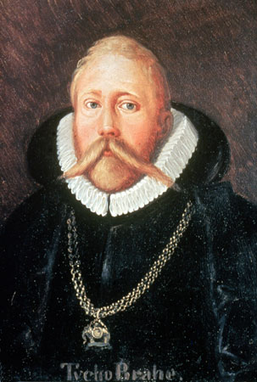
Tycho Brahe
Tycho Brahe (14 December 1546 – 24 October 1601), born Tyge Ottesen Brahe, was a Danish nobleman known for his accurate and comprehensive astronomical and planetary observations. He was born in Scania, then part of Denmark, now part of modern-day Sweden.
Tycho was well known in his lifetime as an astronomer and alchemist and has been described more recently as "the first competent mind in modern astronomy to feel ardently the passion for exact empirical facts.“
As an astronomer, Tycho worked to combine what he saw as the geometrical benefits of the Copernican system with the philosophical benefits of the Ptolemaic system into his own model of the universe, the Tychonic system. Furthermore, he was the last of the major naked eye astronomers, working without telescopes for his observations.

Slide 11
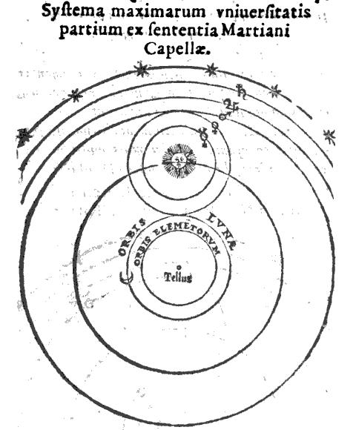
Tycho Brahe
Tycho's observations of stellar and planetary positions were noteworthy both for their accuracy and quantity.
His celestial positions were much more accurate than those of any predecessor or contemporary. Rawlins (1993) asserts of Tycho's Star Catalog D, "In it, Tycho achieved, on a mass scale, a precision far beyond that of earlier catalogers. Cat D represents an unprecedented confluence of skills: instrumental, observational, & computational—all of which combined to enable Tycho to place most of his hundreds of recorded stars to an accuracy of ordermag 1'!“
Tycho was not a Copernican, but proposed a "geo-heliocentric" system in which the Sun and Moon orbited the Earth, while the other planets orbited the Sun. His system provided a safe position for astronomers who were dissatisfied with older models but were reluctant to accept the Earth's motion.
The traditional view of Tycho is that he was primarily an empiricist who set new standards for precise and objective measurements.

Slide 12
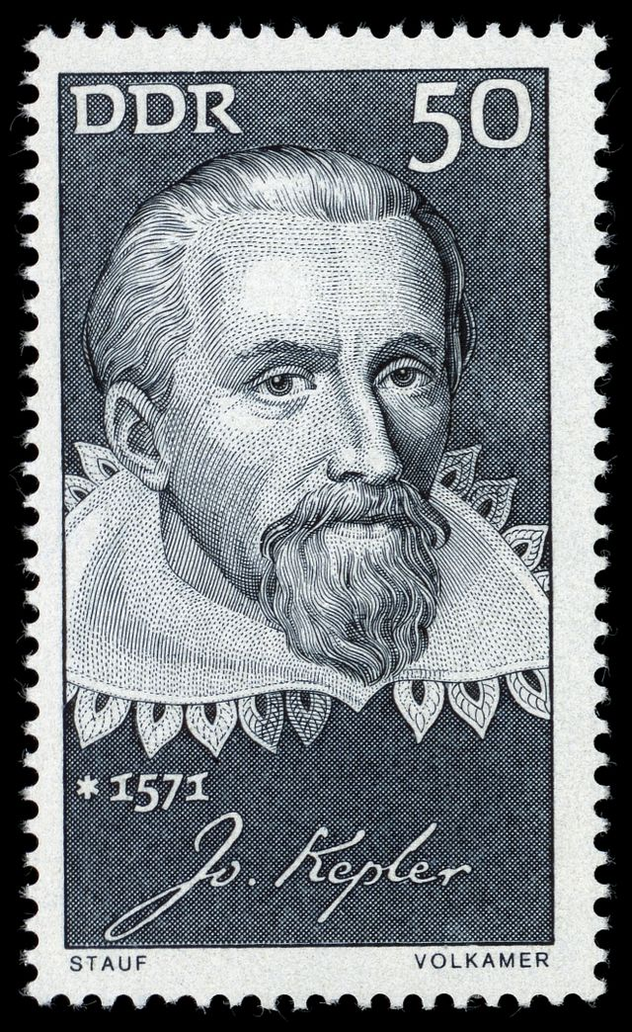
Johannes Kepler
(December 27, 1571 – November 15, 1630) was a German mathematician, astronomer, and astrologer.
A key figure in the 17th century scientific revolution, he is best known for his laws of planetary motion, based on his works Astronomia nova, Harmonices Mundi, and Epitome of Copernican Astronomy.
These works also provided one of the foundations for Isaac Newton's theory of universal gravitation.

Slide 13
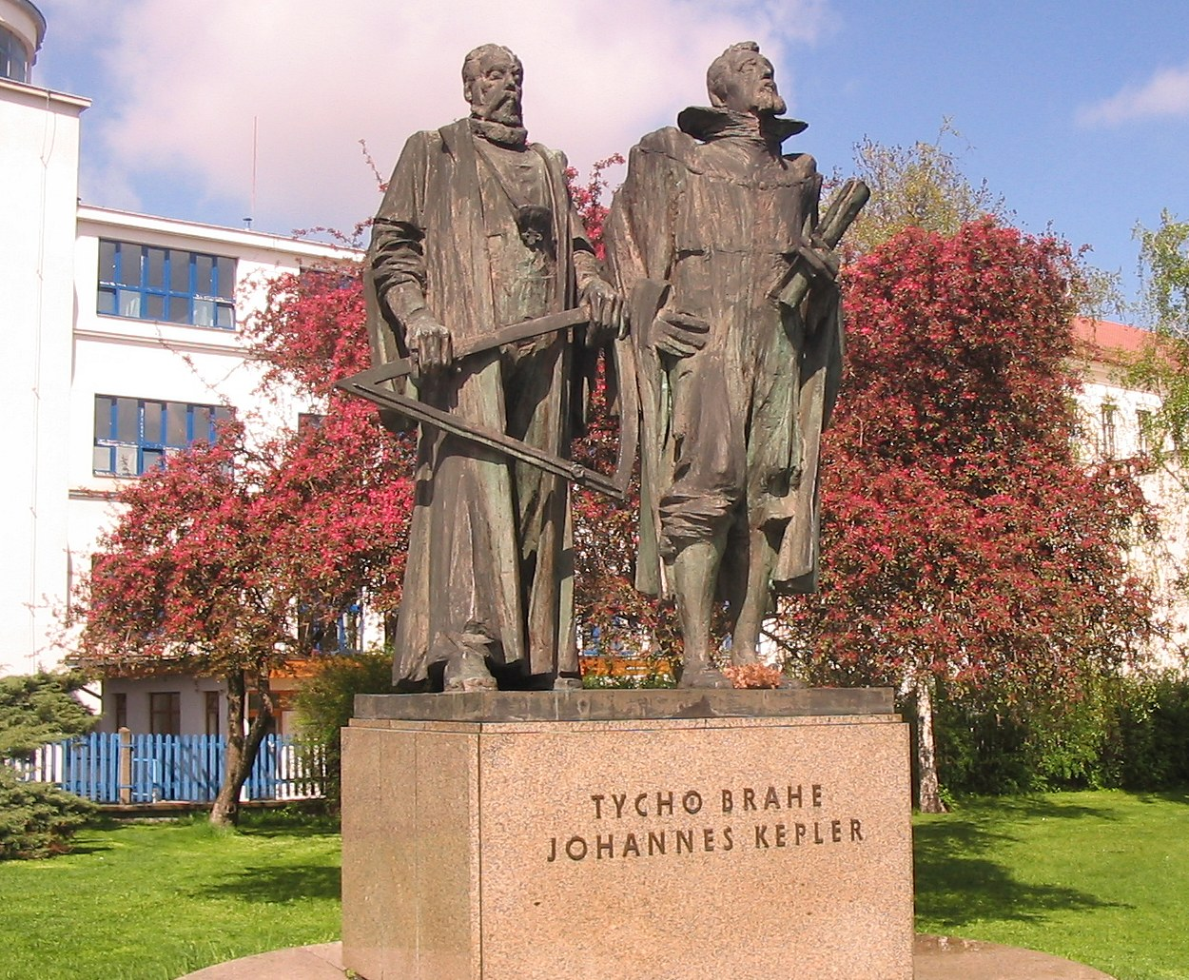
Johannes Kepler
On February 4, 1600, Kepler met Tycho Brahe. Over the next two months he stayed as a guest, analyzing some of Tycho's observations of Mars; Tycho guarded his data closely, but was impressed by Kepler's theoretical ideas and soon allowed him more access.
Kepler planned to test his theory from Mysterium Cosmographicum based on the Mars data, but he estimated that the work would take up to two years (since he was not allowed to simply copy the data for his own use).
Kepler attempted to negotiate a more formal employment arrangement with Tycho, but negotiations broke down in an angry argument and Kepler left for Prague on April 6. Kepler and Tycho soon reconciled and eventually reached an agreement on salary and living arrangements.

Slide 14
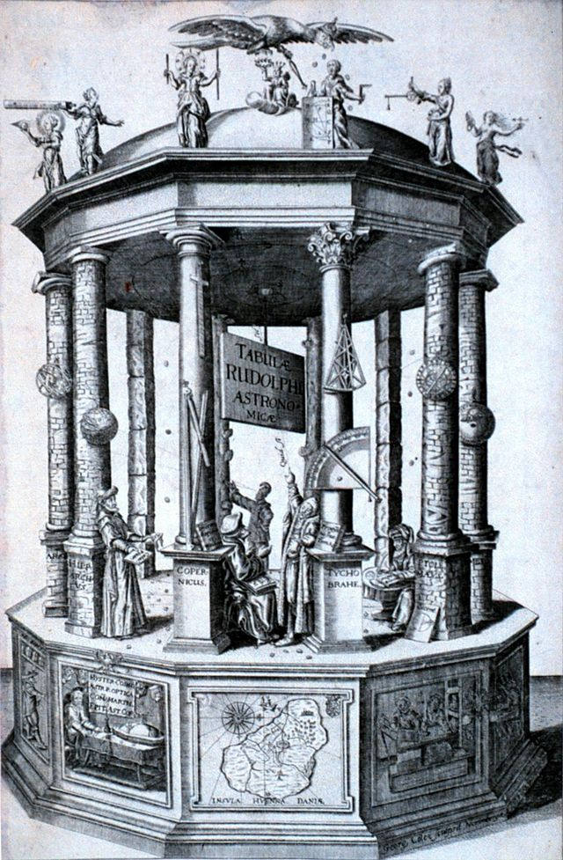
Johannes Kepler
In September 1600, Tycho secured him a commission as a collaborator on the new project he had proposed to Emperor Rudolf II: the Rudolphine Tables.
Two days after Tycho's unexpected death on October 24, 1601, Kepler was appointed his successor as imperial mathematician with the responsibility to complete his unfinished work. The next 11 years as imperial mathematician would be the most productive of his life.
Tycho Brahe had spent much of his life obtaining measurements of the position of stars and planets to a much greater accuracy than had been possible previously. He wished these observations to be the basis of a new and more accurate set of star tables.
Kepler was able to prepare these new tables using Tycho's accurate observations together with a heliocentric model of the solar system and his own discovery of the elliptical orbits of the planets.
Accurate calculation was aided by the newly published system of logarithms which simplified accurate calculation and made them less prone to errors.
Johannes Kepler published his first two laws about planetary motion in 1609, having found them by analyzing the astronomical observations of Tycho Brahe.
Kepler's third law was published in 1619.
Kepler’s observations mathematically predicted planetary motions, but did not explain why. His work was not fully accepted until Newton explained the physics behind the mathematics.

Slide 15
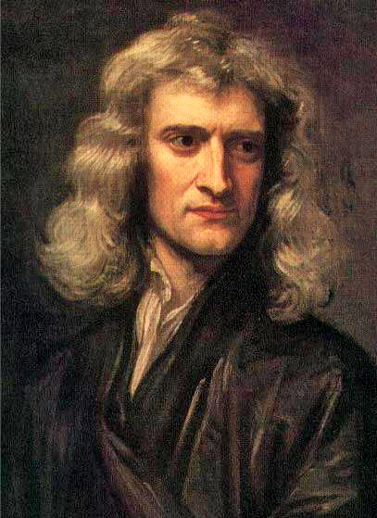
Isaac Newton
(25 December 1642 – 20 March 1727) was an English physicist and mathematician (described in his own day as a "natural philosopher") who is widely recognized as one of the most influential scientists of all time and as a key figure in the scientific revolution.
His book Philosophiæ Naturalis Principia Mathematica ("Mathematical Principles of Natural Philosophy"), first published in 1687, laid the foundations for classical mechanics. Newton also made seminal contributions to optics and shares credit with Gottfried Leibniz for the invention of calculus.
Newton's Principia formulated the laws of motion and universal gravitation, which dominated scientists' view of the physical universe for the next three centuries. By deriving Kepler's laws of planetary motion from his mathematical description of gravity, and then using the same principles to account for the trajectories of comets, the tides, the precession of the equinoxes, and other phenomena, Newton removed the last doubts about the validity of the heliocentric model of the cosmos.
This work also demonstrated that the motion of objects on Earth and of celestial bodies could be described by the same principles. His prediction that the Earth should be shaped as an oblate spheroid was later vindicated by the measurements of Maupertuis, La Condamine, and others, which helped convince most Continental European scientists of the superiority of Newtonian mechanics over the earlier system of Descartes.

Slide 16
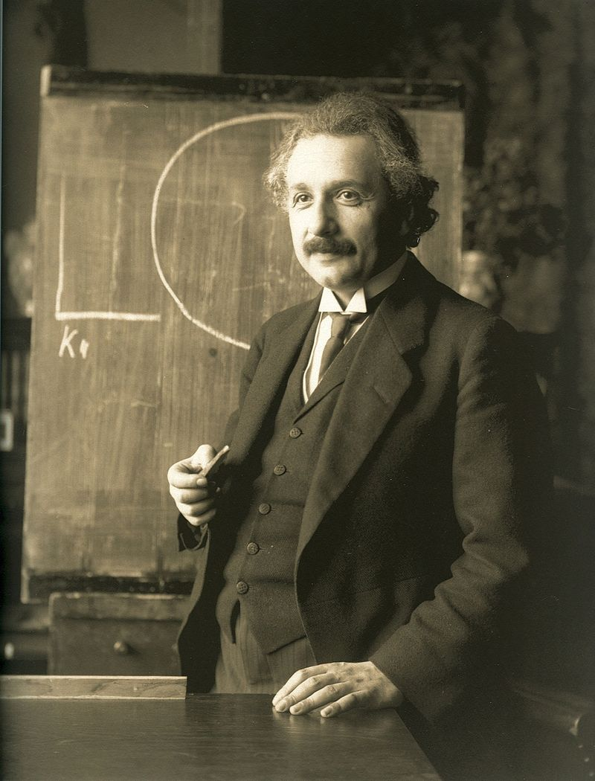
Albert Einstein
Einstein thought that Newtonian mechanics was no longer enough to reconcile the laws of classical mechanics with the laws of the electromagnetic field. This led to the development of his special theory of relativity.
He realized, however, that the principle of relativity could also be extended to gravitational fields, and with his subsequent theory of gravitation in 1916, he published a paper on the general theory of relativity.
He continued to deal with problems of statistical mechanics and quantum theory, which led to his explanations of particle theory and the motion of molecules.
In 1917, Einstein applied the general theory of relativity to model the large-scale structure of the universe. The theory includes orbital gravitational attraction on a large scale.

Slide 17
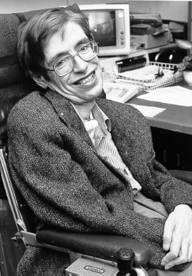
Stephen Hawking
(born 8 January 1942) is an English theoretical physicist, cosmologist, author and Director of Research at the Centre for Theoretical Cosmology within the University of Cambridge.
Among his significant scientific works have been a collaboration with Roger Penrose on gravitational singularity theorems in the framework of general relativity, and the theoretical prediction that black holes emit radiation, often called Hawking radiation.
Hawking was the first to set forth a cosmology explained by a union of the general theory of relativity and quantum mechanics.

Slide 18
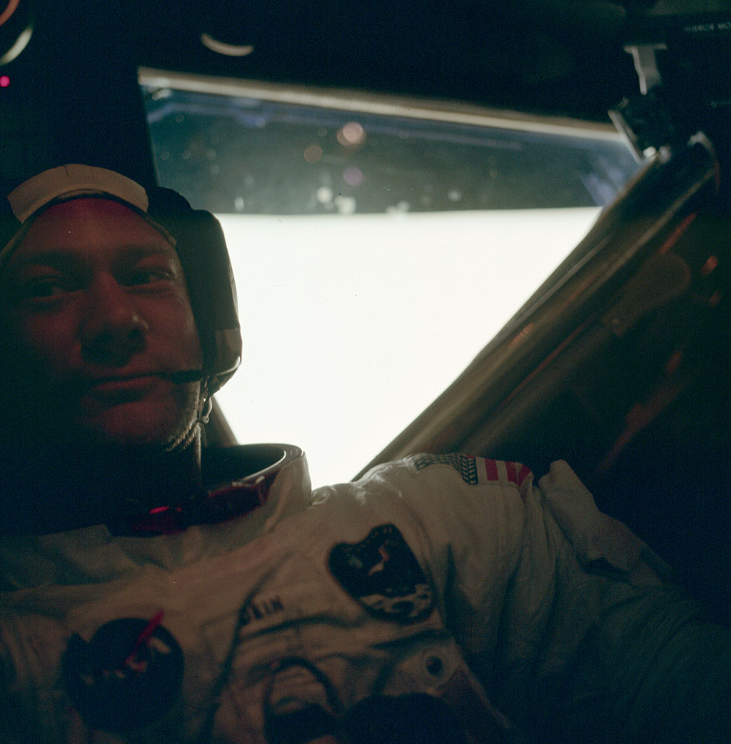
Edwin “Buzz” Aldrin
(born Edwin Eugene Aldrin, Jr., January 20, 1930) is an engineer and former American astronaut, and the second person to walk on the Moon.
He was the lunar module pilot on Apollo 11, the first manned lunar landing in history. He set foot on the Moon at 03:15:16 (UTC) on July 21, 1969, following mission commander Neil Armstrong.
A Mars cycler (or Earth-Mars cycler) is a special kind of spacecraft trajectory that encounters Earth and Mars on a regular basis. The Aldrin cycler is an example of a Mars cycler.
A cycler trajectory encounters two or more bodies on a regular basis.
Cyclers are potentially useful for transporting people or materials between those bodies using minimal propellant (relying on gravity-assist flybys for most trajectory changes), and can carry heavy radiation shielding to protect people in transit from cosmic rays and solar storms.

Slide 19
July 12, 2014
Orbital Research is on-going
The paper “Revisiting elliptical satellite orbits to enhance the O3b constellation” by Lloyd Wood, Yuxuan Lou, and Opeoluwa Olusola of the University of Surrey is now available. (see AMSAT-UK)

Slide 20
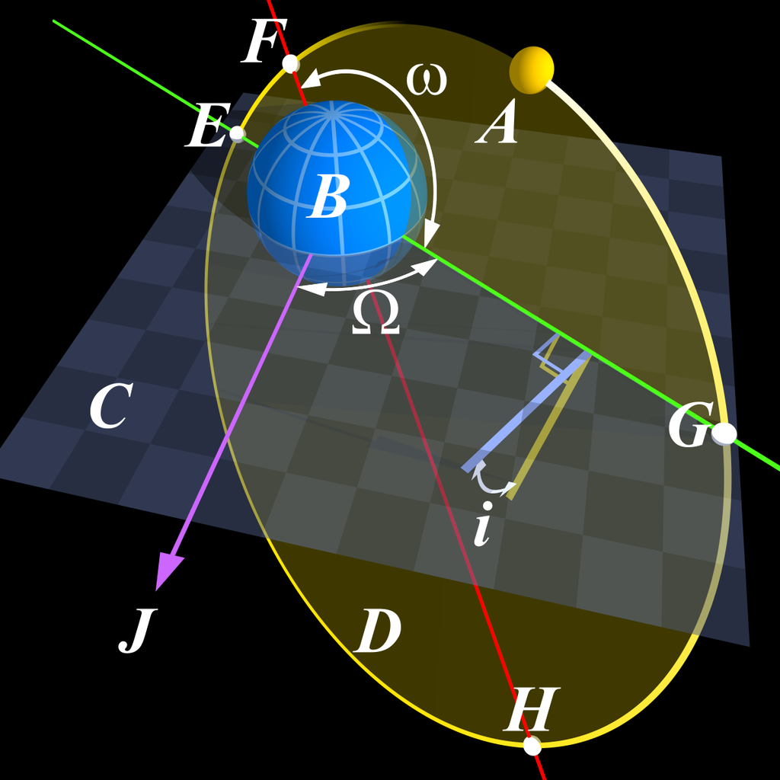
Kepler’s Three Laws
Johann Kepler determined three laws characterizing orbital motion, using Tycho Brahe's planetary observation data. These laws can be proven mathematically using Newton's law of gravitation. Kepler's laws are paraphrased below along with the corresponding physical implications.
These laws apply directly to satellite orbital motion, thus the laws are from the point of view of an Earth-orbiting satellite.

Slide 21
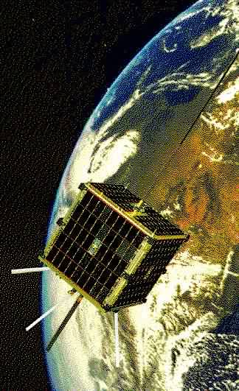
Kepler’s Three Laws (of Satellites)
Kepler's laws describe orbital motion
Orbital motion described by Kepler's laws has it roots in basic Physics
Kepler's first law -- orbits are ellipses -- this is a balance of velocity with gravity
Kepler's second law -- equal areas swept out in equal time describes conservation of angular momentum
Kepler's third law -- the size of the orbit's ellipse tells you how much time it takes to complete one orbit

Slide 22
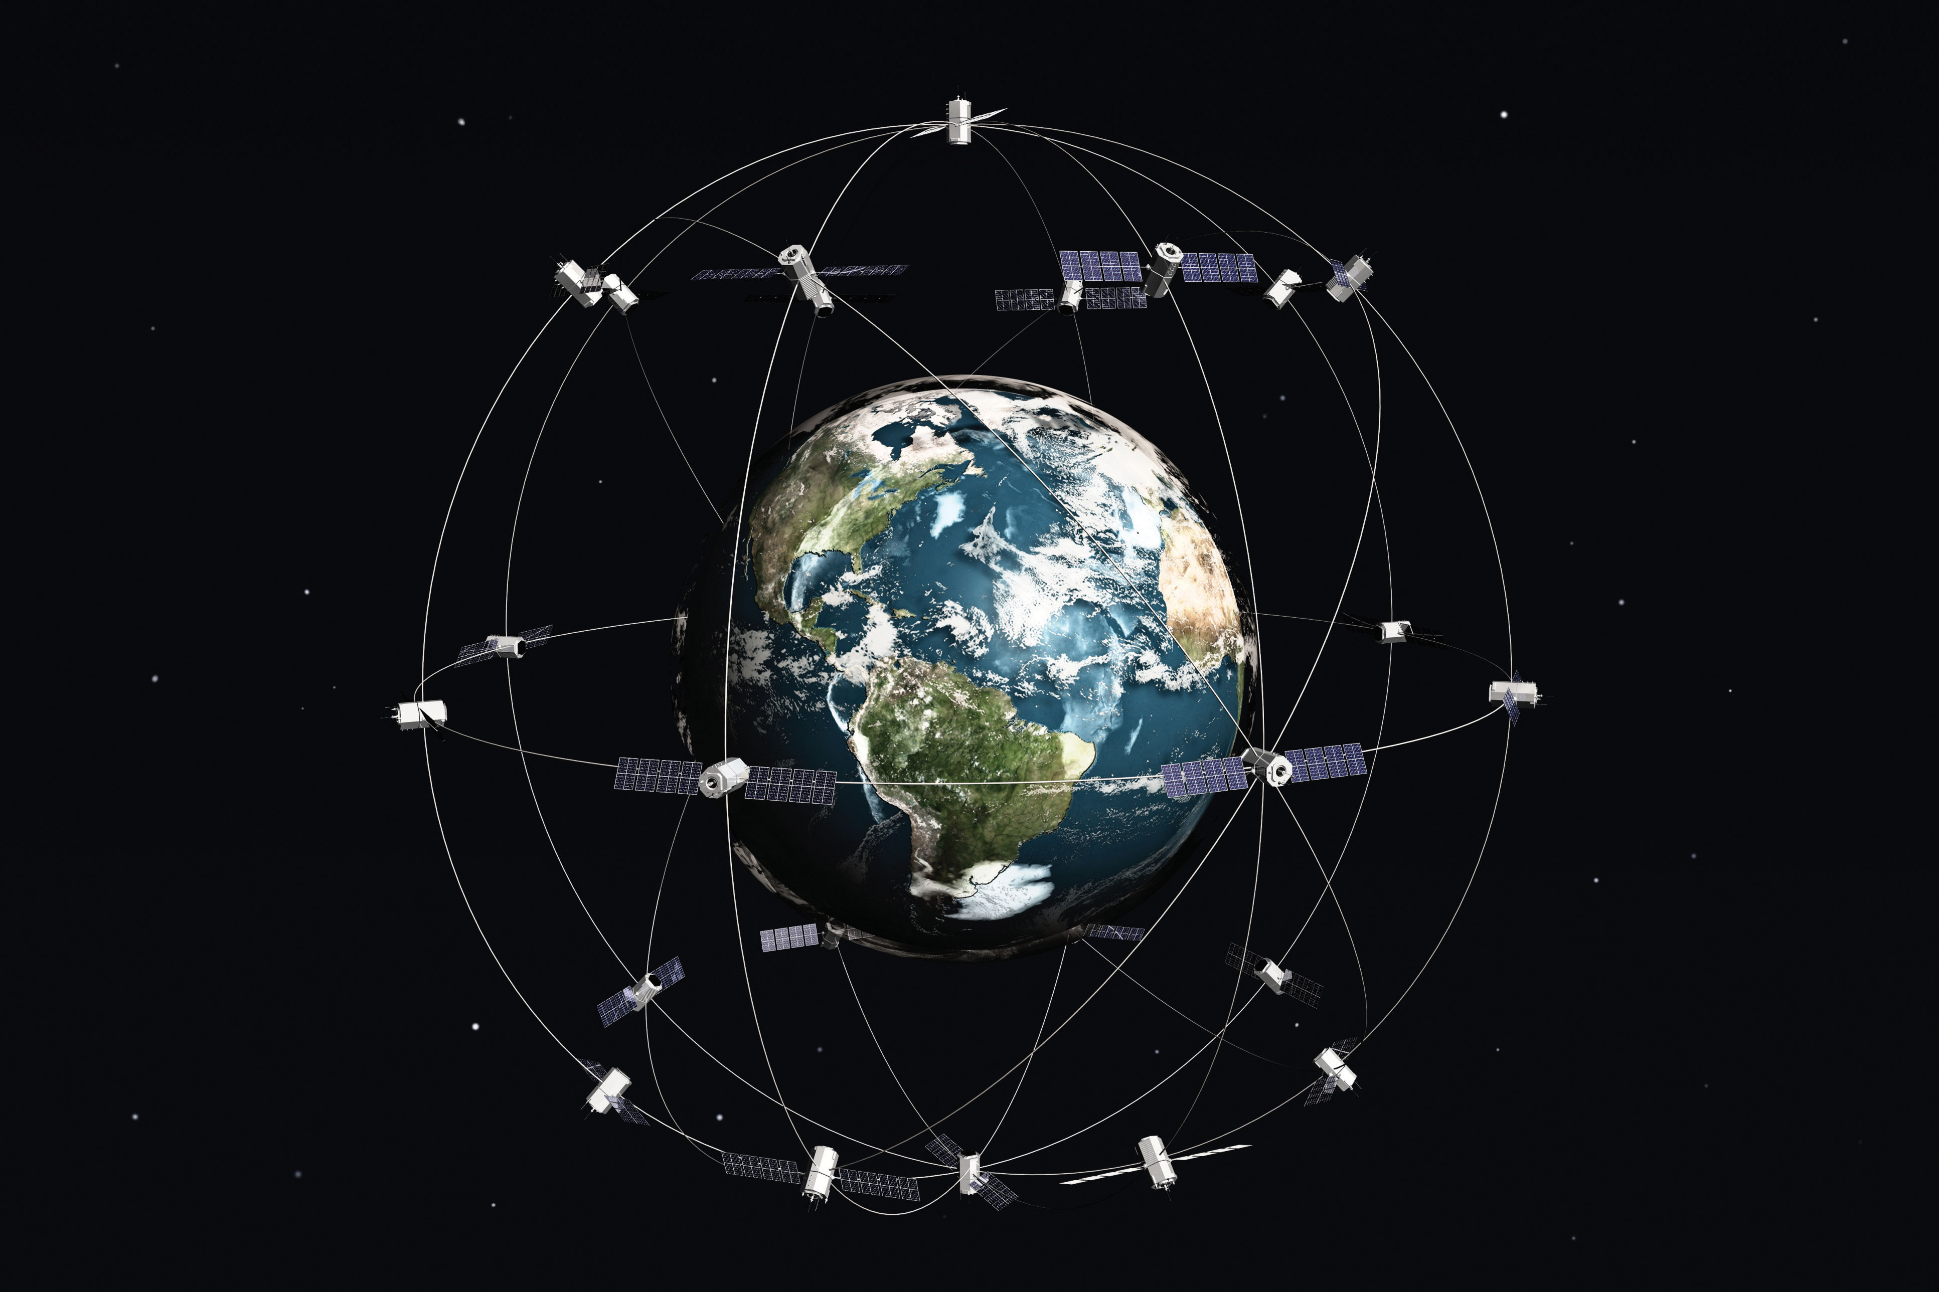
Kepler’s Three Laws
Kepler's First Law
Satellite orbits are elliptical Paths with the Earth at one focus of the ellipse.
Kepler's first law simply states that orbits are shaped like ellipses (elongated circles). This can be proven mathematically, once it's understood that the gravitational force between the Earth and the satellite decreases in proportion to the square of distance between the [centers of] the two. This law does not preclude a satellite from orbiting in a circular path since a circle is an ellipse with no elongation (or eccentricity).
Two things are needed for a satellite to orbit in a circular path:
It's velocity must be directed perfectly horizontally and
It's speed (or velocity magnitude) must be perfectly balanced against the Earth's gravitational acceleration (at the orbital altitude). To get this balance, the speed must have the value that would cause the gravity to be what Physicists call a centripetal acceleration.
Any differences in the velocity (speed or direction) from these two conditions will cause either an elliptical path or an escape trajectory (with a parabolic or hyperbolic shape). A significant lack of speed or a poorly-chosen direction can cause part of the elliptical path to intersect the Earth, in which case the satellite will re-enter the atmosphere and either burn up or impact the surface.

Slide 23
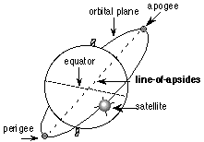
Kepler’s Three Laws
Kepler's Second Law
A line between the center of the Earth and the satellite sweeps out equal areas in equal intervals of time.
Kepler's Second Law is also a consequence of the physical law of conservation of angular momentum. This is the same principle that figure skaters use by pulling in their arms to speed up their spin rate and extend them out to slow their spin rate down. This effect is amplified by gravity's inverse square law dictating lower speeds at higher altitudes and vice versa.
This gives elliptical orbits a very distinct characteristic: the satellite moves fastest at its lowest altitude (perigee) and it moves slowest at its highest altitude (apogee). This speed change is dramatic in highly elliptical orbits in which the satellite spends the majority of its time moving rather slowly near apogee.

Slide 24
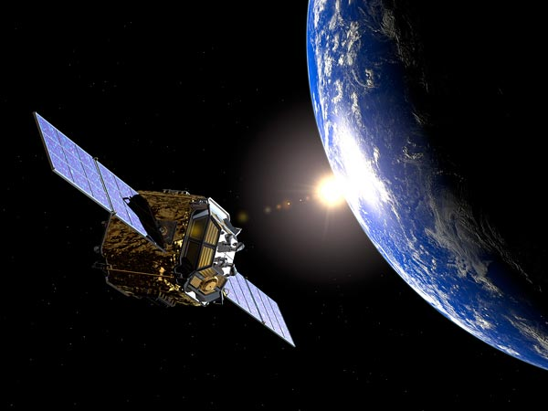
Kepler’s Three Laws
Kepler's Third Law
The square of the orbital period is proportional to the cube of the orbit's semi major axis.
Kepler's Third Law states that you can compute the time it takes the satellite to make one complete orbit (the period) from half the longest dimension of the orbital ellipse (the semi major axis). This is also known as the harmonic law.
The mathematical relationship between period and semi major axis in the harmonic law results from two things:
larger ellipses have a longer orbital path, so (if everything else was equal) you would expect it to take more time to go around the longer path and
gravity's inverse square law dictates lower speeds at higher altitudes and higher speeds at lower altitudes.

Slide 25
Definition- Orbit Types
LEO – Low Earth Orbit
A low Earth orbit (LEO) is an orbit around Earth with an altitude between 160 kilometers (99 mi), with an orbital period of about 88 minutes, and 2,000 kilometers (1,200 mi), with an orbital period of about 127 minutes.
Objects below approximately 160 kilometers (99 mi) will experience very rapid orbital decay and altitude loss.
With the exception of the manned lunar flights of the Apollo program, all human spaceflights have taken place in LEO (or were suborbital). The altitude record for a human spaceflight in LEO was Gemini 11 with an apogee of 1,374.1 kilometers (853.8 mi). All manned space stations to date, as well as the majority of artificial satellites, have been in LEO.
Objects in LEO encounter atmospheric drag in the form of gases in the thermosphere (approximately 80–500 km up) or exosphere (approximately 500 km and up), depending on orbit height. Objects in LEO orbit Earth between the atmosphere and below the inner Van Allen radiation belt. The altitude is usually not less than 300 km for satellites, as that would be impractical due to atmospheric drag.
The orbital velocity needed to maintain a stable low earth orbit is about 7.8 km/s, but reduces with increased orbital altitude. The delta-v needed to achieve low earth orbit starts around 9.4 km/s. Atmospheric and gravity drag associated with launch typically adds 1.5–2.0 km/s to the delta-v launch vehicle required to reach normal LEO orbital velocity of around 7.8 km/s (28,080 km/h).

Slide 26
Definition- Orbit Types
MEO – Medium Earth Orbit
Medium Earth orbit (MEO), sometimes called intermediate circular orbit (ICO), is the region of space around the Earth above low Earth orbit (altitude of 2,000 kilometers (1,243 mi)) and below geostationary orbit (altitude of 35,786 kilometers (22,236 mi)).
The most common use for satellites in this region is for navigation, communication, and geodetic/space environment science.
The most common altitude is approximately 20,200 kilometers (12,552 mi)), which yields an orbital period of 12 hours, as used, for example, by the Global Positioning System (GPS).
Other satellites in Medium Earth Orbit include Glonass (with an altitude of 19,100 kilometers (11,868 mi)) and Galileo (with an altitude of 23,222 kilometers (14,429 mi)) constellations.
Communications satellites that cover the North and South Pole are also put in MEO.
The orbital periods of MEO satellites range from about 2 to nearly 24 hours

Slide 27
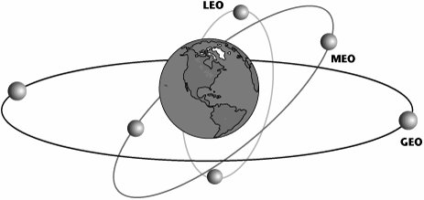
Definition- Orbit Types
HEO – High Earth Orbit
A high Earth orbit is a geocentric orbit with an altitude entirely above that of a geosynchronous orbit (35,786 kilometers (22,236 mi)).
The orbital periods of such orbits are greater than twenty-four hours, therefore satellites in such orbits have an apparent retrograde motion – that is, even if they are in a prograde orbit (90° > inclination >= 0°), their orbital velocity is lower than Earth's rotational speed, causing their ground track to move westward on Earth's.

Slide 28
Definition- Orbit Types
GEO – Geosynchronous Earth Orbit
A geosynchronous Earth orbit (sometimes abbreviated GSO) is an orbit around the Earth with an (approximately 23 hours 56 minutes and 4 seconds), matching the Earth's sidereal rotation period.
The synchronization of rotation and orbital period means that, for an observer on the surface of the Earth, an object in geosynchronous orbit returns to exactly the same position in the sky after a period of one sidereal day. Over the course of a day, the object's position in the sky traces out a path, typically in the form of an analemma, whose precise characteristics depend on the orbit's inclination and eccentricity.
A special case of geosynchronous orbit is the geostationary orbit, which is a circular geosynchronous orbit at zero inclination (that is, directly above the equator). A satellite in a geostationary orbit appears stationary, always at the same point in the sky, to ground observers. Popularly or loosely, the term "geosynchronous" may be used to mean geostationary. Specifically, geosynchronous Earth orbit (GEO) may be a synonym for geosynchronous equatorial orbit, or geostationary earth orbit.
Author Arthur C. Clarke is credited with proposing the notion of using a geostationary orbit for communications satellites. The orbit is also known as the Clarke Orbit. Together, the collection of artificial satellites in these orbits is known as the Clarke Belt.

Slide 29
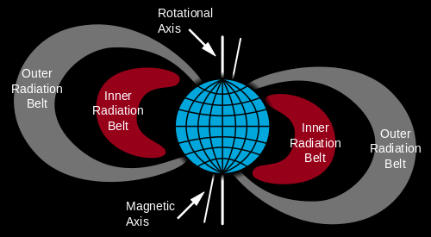
Definition – Orbit – Van Allen Radiation Belt
A Van Allen radiation belt is one of at least two layers of energetic charged particles (plasma) that is held in place around the planet Earth by the planet's magnetic field.
The belts extend from an altitude of about 1,000 to 60,000 kilometers above the surface in which region radiation levels vary. Most of the particles that form the belts are thought to come from solar wind and other particles by cosmic rays.
The belts are named after their discoverer, James Van Allen, and are located in the inner region of the Earth's magnetosphere. The belts contain energetic electrons that form the outer belt and a combination of protons and electrons that form the inner belt.
The radiation belts additionally contain lesser amounts of other nuclei, such as alpha particles.
The belts endanger satellites, which must protect their sensitive components with adequate shielding if their orbit spends significant time in the radiation belts.
In 2013, NASA reported that the Van Allen Probes had discovered a transient, third radiation belt, which was observed for four weeks until destroyed by a powerful, interplanetary shock wave from the Sun.

Slide 30
Definition – Orbit Size & Shape
Apogee
or more formally apsis, is the point, in an elliptical Earth orbit, of greatest distance from the Earth.
The point in a satellite’s orbit where it is farthest from the earth.
Perigee
the point in outer space where an object traveling around the Earth (such as a satellite or the moon) is closest to the Earth
The point in a satellite’s orbit where it is closest to the earth.

Slide 31
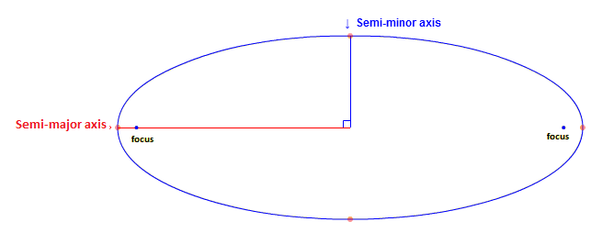
Definition – Orbit Size & Shape
Semi-Major Axis
In geometry, the major axis of an ellipse is the longest diameter: a line (line segment) that runs through the center and both foci, with ends at the widest points of the shape.
The semi-major axis is one half of the major axis, and thus runs from the center, through a focus, and to the edge of the ellipse; essentially, it is the radius of an orbit at the orbit's two most distant points.
For the special case of a circle, the semi-major axis is the radius.
One can think of the semi-major axis as an ellipse's long radius.

Slide 32
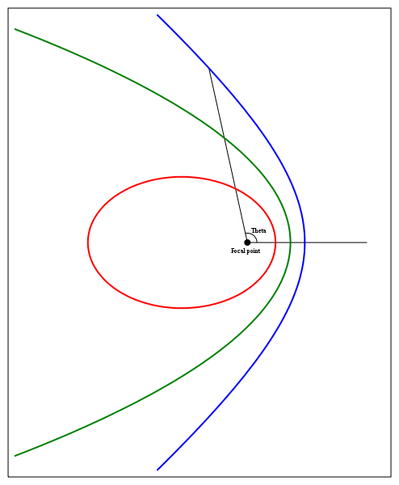
Definition – Orbit Size & Shape
Eccentricity
The orbital eccentricity of an astronomical object is a parameter that determines the amount by which its orbit around another body deviates from a perfect circle.
A value of 0 is a circular orbit, values between 0 and 1 form an elliptical orbit, 1 is a parabolic escape orbit, and greater than 1 is a hyperbola.
The term derives its name from the parameters of conic sections, as every Kepler orbit is a conic section.

Slide 33
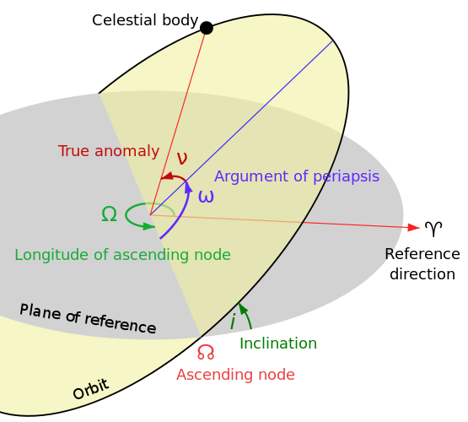
Definition – Orbit Orientation
Orbital Inclination
[aka "Inclination" or "I0"]
The orbit ellipse lies in a plane known as the orbital plane. The orbital plane always goes through the center of the earth, but may be tilted any angle relative to the equator.
Inclination is the angle between the orbital plane and the equatorial plane.
By convention, inclination is a number between 0 and 180 degrees.
Some vocabulary: Orbits with inclination near 0 degrees are called equatorial orbits (because the satellite stays nearly over the equator). Orbits with inclination near 90 degrees are called polar (because the satellite crosses over the north and south poles). The intersection of the equatorial plane and the orbital plane is a line which is called the line of nodes.

Slide 34
Definition – Orbit Orientation
Right Ascension of the Ascending Node
[aka "RAAN" or "RA of Node" or "O0", and occasionally called "Longitude of Ascending Node"]
RAAN wins the prize for most horribly named orbital element. Two numbers orient the orbital plane in space. The first number was Inclination. RAAN is the second. After we've specified inclination, there are still an infinite number of orbital planes possible. The line of nodes can poke out the anywhere along the equator. If we specify where along the equator the line of nodes pokes out, we will have the orbital plane fully specified. The line of nodes pokes out two places, of course. We only need to specify one of them. One is called the ascending node (where the satellite crosses the equator going from south to north). The other is called the descending node (where the satellite crosses the equator going from north to south). By convention, we specify the location of the ascending node.
Now, the earth is spinning. This means that we can't use the common latitude/longitude coordinate system to specify where the line of nodes points. Instead, we use an astronomical coordinate system, known as the right ascension / declination coordinate system, which does not spin with the earth. Right ascension is another fancy word for an angle, in this case, an angle measured in the equatorial plane from a reference point in the sky where right ascension is defined to be zero. Astronomers call this point the vernal equinox.
Finally, "right ascension of ascending node" is an angle, measured at the center of the earth, from the vernal equinox to the ascending node.
I know this is getting complicated. Here's an example. Draw a line from the center of the earth to the point where our satellite crosses the equator (going from south to north). If this line points directly at the vernal equinox, then RAAN = 0 degrees.
By convention, RAAN is a number in the range 0 to 360 degrees.

Slide 35
Definition – Orbit Orientation
Right Ascension of the Ascending Node
The term "vernal equinox" was used above without really defining it. If you can tolerate a minor digression, here’s the definition.
Teachers have told children for years that the vernal equinox is "the place in the sky where the sun rises on the first day of Spring". This is a horrible definition. Most teachers, and students, have no idea what the first day of spring is (except a date on a calendar), and no idea why the sun should be in the same place in the sky on that date every year.
Consider the orbit of the sun around the earth. I know in school they told you the earth orbits around the sun, but the math is equally valid either way, and it suits our needs at this instant to think of the sun orbiting the earth. The orbit of the sun has an inclination of about 23.5 degrees.
(Astronomers don't usually call this 23.5 degree angle an 'inclination', by the way. They use an infinitely more obscure name: The Obliquity of The Ecliptic.)
The orbit of the sun is divided (by humans) into four equally sized portions called seasons. The one called Spring begins when the sun pops up past the equator. In other words, the first day of Spring is the day that the sun crosses through the equatorial plane going from South to North.
We have a name for that! It's the ascending node of the Sun's orbit. So finally, the vernal equinox is nothing more than the ascending node of the Sun's orbit. The Sun's orbit has RAAN = 0 simply because we've defined the Sun's ascending node as the place from which all ascending nodes are measured.
The RAAN of your satellite's orbit is just the angle (measured at the center of the earth) between the place the Sun's orbit pops up past the equator, and the place your satellite's orbit pops up past the equator.

Slide 36
Definition – Orbit Orientation
Argument of Perigee
[aka "ARGP" or "W0"]
Argument is yet another fancy word for angle. Now that we've oriented the orbital plane in space, we need to orient the orbit ellipse in the orbital plane. We do this by specifying a single angle known as argument of perigee.
A quick review about elliptical orbits... The point where the satellite is closest to the earth is called perigee, although it's sometimes called periapsis or perifocus. We'll call it perigee. The point where the satellite is farthest from earth is called apogee (aka apoapsis, or apifocus). If we draw a line from perigee to apogee, this line is called the line-of-apsides. (Apsides is, of course, the plural of apsis.) I know, this is getting complicated again. Sometimes the line-of-apsides is called the major-axis of the ellipse. It's just a line drawn through the ellipse the "long way".
The line-of-apsides passes through the center of the earth. We've already identified another line passing through the center of the earth: the line of nodes. The angle between these two lines is called the argument of perigee. Where any two lines intersect, they form two supplementary angles, so to be specific, we say that argument of perigee is the angle (measured at the center of the earth) from the ascending node to perigee.
Example: When ARGP = 0, the perigee occurs at the same place as the ascending node. That means that the satellite would be closest to earth just as it rises up over the equator. When ARGP = 180 degrees, apogee would occur at the same place as the ascending node. That means that the satellite would be farthest from earth just as it rises up over the equator.
By convention, ARGP is an angle between 0 and 360 degrees.

Slide 37
Definition – Orbit Orientation
True Anomaly
The angular parameter that defines the position of a body moving along a Keplerian orbit. It is the angle between the direction of periapsis and the current position of the body, as seen from the main focus of the ellipse (the point around which the object orbits).
True anomaly is the angle measured in the direction of motion from perigee to the satellite's position at some defined epoch time.
Epoch Time
[aka "Epoch Time" or "T0"]
A set of orbital elements is a snapshot, at a particular time, of the orbit of a satellite. Epoch is simply a number which specifies the time at which the snapshot was taken.
Mean Anomaly
[aka "M0" or "MA" or "Phase"]
Anomaly is yet another astronomer-word for angle. Mean anomaly is simply an angle that marches uniformly in time from 0 to 360 degrees during one revolution. It is defined to be 0 degrees at perigee, and therefore is 180 degrees at apogee.
Mean anomaly describes what the satellite's true anomaly would be if it were in a circular orbit. You can compute mean anomaly from the orbit's true anomaly and eccentricity. The commonly available Keplerian elements use mean anomaly.
If you had a satellite in a circular orbit (therefore moving at constant speed) and you stood in the center of the earth and measured this angle from perigee, you would point directly at the satellite. Satellites in non-circular orbits move at a non-constant speed, so this simple relation doesn't hold. This relation does hold for two important points on the orbit, however, no matter what the eccentricity. Perigee always occurs at MA = 0, and apogee always occurs at MA = 180 degrees.
It has become common practice with radio amateur satellites to use Mean Anomaly to schedule satellite operations. Satellites commonly change modes or turn on or off at specific places in their orbits, specified by Mean Anomaly. Unfortunately, when used this way, it is common to specify MA in units of 256ths of a circle instead of degrees! Some tracking programs use the term "phase" when they display MA in these units. It is still specified in degrees, between 0 and 360, when entered as an orbital element.

Slide 38
Definition – Terra-based - Location
Latitude
Latitude (φ) is a geographic coordinate that specifies the north-south position of a point on the Earth's surface. Latitude is an angle which ranges from 0° at the Equator to 90° (North or South) at the poles.
Longitude
Longitude is a geographic coordinate that specifies the east-west position of a point on the Earth's surface. It is an angular measurement, usually expressed in degrees and denoted by the Greek letter lambda (λ).
Points with the same longitude lie in lines running from the North Pole to the South Pole. By convention, one of these, the Prime Meridian, which passes through the Royal Observatory, Greenwich, England, was intended to establish the position of zero degrees longitude. The longitude of other places was to be measured as the angle east or west from the Prime Meridian, ranging from 0° at the Prime Meridian to +180° eastward and −180° westward.
Specifically, it is the angle between a plane containing the Prime Meridian and a plane containing the North Pole, South Pole and the location in question.

Slide 39
Definition – Terra-based - Location
Altitude (Elevation)
Altitude or height is defined based on the context in which it is used (aviation, geometry, geographical survey, sport, and more). As a general definition, altitude is a distance measurement, usually in the vertical or "up" direction, between a reference datum and a point or object. The reference datum also often varies according to the context.
Elevation is mainly used when referring to points on the Earth's surface, altitude is used for points above the surface, such as a spacecraft in orbit. Elevation for satellite prediction is the highest angle over the observer’s location.
Acquisition of Signal (AOS)
AOS stands for Acquisition of Signal (or Satellite). AOS is the time that a satellite rises above the horizon of an observer.
Culmination Point (CUL)
Culmination point (maximum elevation)
Loss of Signal (LOS)
LOS stands for Loss of Signal (or Satellite). LOS is the time that a satellite passes below the observer’s horizon.

Slide 40
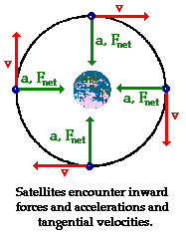
Definition – Apparent Motion
Velocity
Velocity is the rate of change of the position of an object, equivalent to a specification of its speed and direction of motion.
Heading
the angle between the direction to a fixed reference object (typically true north) and the tangent line to the path over the ground the vehicle intends to follow.

Slide 41
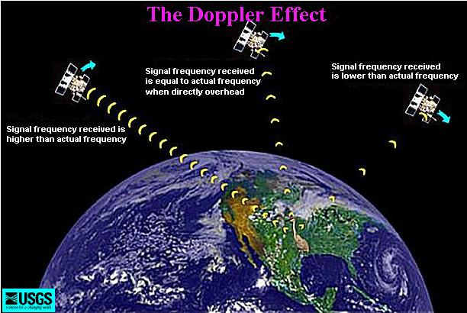
Definition – Space Based
Doppler Shift
The Doppler effect is observed whenever the source of waves is moving with respect to an observer.
The Doppler effect can be described as the effect produced by a moving source of waves in which there is an apparent upward shift in frequency for observers towards whom the source is approaching and an apparent downward shift in frequency for observers from whom the source is receding.
Fast moving satellites can have a Doppler shift of dozens of kilohertz relative to a ground station. The speed, thus magnitude of Doppler effect, changes due to earth curvature.

Slide 42
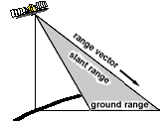
Definition – Space Based
Range Rate
Relative velocity along the line of sight between the satellite and an observer (useful for Doppler computations).
Slant Range
Direct range from you to the satellite.
State Vectors
Satellite tracking software routinely computes satellite positions and velocities from Keplerian elements. Since the six components of a position velocity state vector and the associated time are independent, these also provide a complete description of a satellite's orbit. Thus, the six osculating Keplerian elements may be computed from a state vector.
The conversion of state vectors to Keplerian elements is a useful process since there are times when a position and velocity is the only available orbital information.

Slide 43
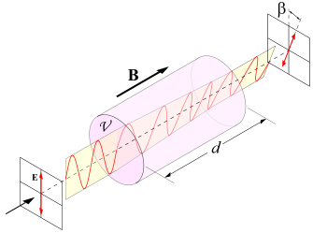
Definition – Space Based
Faraday Rotation
Radio waves passing through the Earth's ionosphere are subject to the Faraday effect. The ionosphere consists of a plasma containing free electrons which contribute to Faraday rotation, whereas the positive ions are relatively massive and have little influence. In conjunction with the earth's magnetic field, rotation of the polarization of radio waves thus occurs.
Since the density of electrons in the ionosphere varies greatly on a daily basis, as well as over the sunspot cycle, the magnitude of the effect varies. However the effect is always proportional to the square of the wavelength, so even at the UHF television frequency of 500 MHz (λ = 60 cm), there can be more than a complete rotation of the axis of polarization.
A consequence is that although most radio transmitting antennas are either vertically or horizontally polarized, the polarization of a medium or short wave signal after reflection by the ionosphere is rather unpredictable.
The Faraday effect due to free electrons diminishes rapidly at higher frequencies (shorter wavelengths) so that at microwave frequencies, used by satellite communications, the transmitted polarization is maintained between the satellite and the ground.
From an operational viewpoint, Faraday Rotation is important at 29 MHz, of minor concern at 146 MHz, and of little effect at higher frequencies.

Slide 44
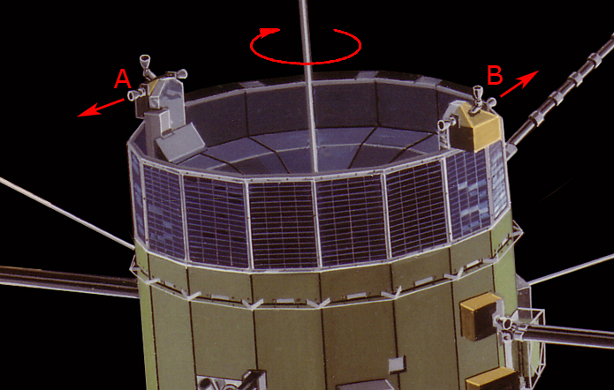
Definition – Space Based
Spin Modulation
Satellites are often stabilized by being spun about a particular axis. When a spacecraft spin axis is not pointing directly at the ground station (non-zero squint angle), the signal will likely exhibit amplitude, and possibly polarization, changes resulting from the spacecraft rotation.
The changes affect both uplink and downlink signals occur at an integer multiple of the spin rate.
The magnitude of the effect will generally become greater as the squint angle increases.
Unusual Propagation
Ionospheric effects on VHF/UHF, Sporadic E, Magnetic-Field-Aligned-Irregularities (FAI), Antipodal Reception, Auroral Effects, & the Unknown – RF noise ( atmospheric, manmade, cosmic, terrestrial, oxygen & water vapor), attenuation (electron, condensed water vapor, oxygen & water vapor), refraction (ionospheric, tropospheric) and scintillation.

Slide 45
Variables Affecting Strength of the Downlink Received Signal
Satellite (antenna) orientation with respect to ground station.
Satellite spin producing a time-dependent antenna pattern.
Changing Slant Range (inverse power law).
Signal absorption in the ionosphere.
Ground-station antenna pattern.
Faraday rotation.

Slide 46
Keplerian Elements – Seven or Eight Osculating Elements
Seven Elements previously defined:
Epoch
A set of orbital elements is a snapshot, at a particular time, of the orbit of a satellite. Epoch is simply a number which specifies the time at which the snapshot was taken.
Orbital Inclination
The angle between the orbital plane and the equatorial plane.
Right Ascension of Ascending Node (R.A.A.N.)
“Right ascension of ascending node" is an angle, measured at the center of the earth, from the vernal equinox to the ascending node.
Argument of Perigee
The angle between the orbit ellipse and the orbital plane in space.
Eccentricity
The amount by which an objects orbit around another body deviates from a perfect circle
Mean Motion
Number of revolutions (perigee to perigee) completed by satellite in a solar day (1440 minutes).
Mean Anomaly
A number that increases uniformly with time, used to locate satellite position on orbital ellipse.

Slide 47
Keplerian Elements – Seven or Eight Osculating Elements
The Eight Element:
Drag
[aka "N1"]
Drag caused by the earth's atmosphere causes satellites to spiral downward. As they spiral downward, they speed up. The Drag orbital element simply tells us the rate at which Mean Motion is changing due to drag or other related effects. Precisely, Drag is one half the first time derivative of Mean Motion.
Its units are revolutions per day per day. It is typically a very small number. Common values for low-earth-orbiting satellites are on the order of 10^-4. Common values for high-orbiting satellites are on the order of 10^-7 or smaller.
Occasionally, published orbital elements for a high-orbiting satellite will show a negative Drag! At first, this may seem absurd. Drag due to friction with the earth's atmosphere can only make a satellite spiral downward, never upward.
There are several potential reasons for negative drag. First, the measurement which produced the orbital elements may have been in error. It is common to estimate orbital elements from a small number of observations made over a short period of time. With such measurements, it is extremely difficult to estimate Drag. Very ordinary small errors in measurement can produce a small negative drag.
The second potential cause for a negative drag in published elements is a little more complex. A satellite is subject to many forces besides the two we have discussed so far (earth's gravity, and atmospheric drag). Some of these forces (for example gravity of the sun and moon) may act together to cause a satellite to be pulled upward by a very slight amount. This can happen if the Sun and Moon are aligned with the satellite's orbit in a particular way. If the orbit is measured when this is happening, a small negative Drag term may actually provide the best possible 'fit' to the actual satellite motion over a *short* period of time.
You typically want a set of orbital elements to estimate the position of a satellite reasonably well for as long as possible, often several months. Negative Drag never accurately reflects what's happening over a long period of time. Some programs will accept negative values for Drag, but I don't approve of them. Feel free to substitute zero in place of any published negative Drag value.

Slide 48
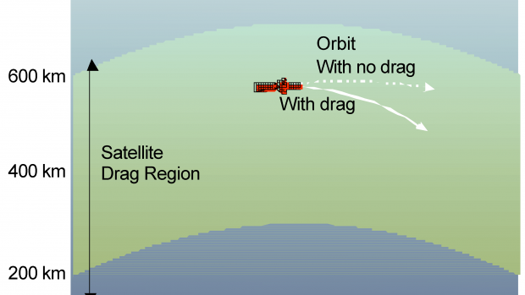
Keplerian Elements – Seven or Eight Osculating Elements
The Eight Element:
Drag – Solar Flux K-Factor
Solar flux is a measurement of the intensity of solar radio emissions with a wavelength of 10.7 cm (a frequency of about 2800 MHz. The daily solar flux measurement is recorded at 2000 UTC by the Dominion Radio Astrophysical Observatory of the Canadian National Research Council located at Penticton, B.C., Canada. The value broadcast is in solar flux units that range from a theoretical minimum of about 50 to numbers larger than 300. During the early part of the 11-year sunspot cycle, the flux numbers are low; but they rise and fall as the cycle proceeds. The numbers will remain high for extended periods around sunspot maximum.
The A and K indices are a measurement of the behavior of the magnetic field in and around the Earth. The K index uses a scale from 0 to 9 to measure the change in the horizontal component of the geomagnetic field. A new K index is determined and added to the broadcast every 3 hours based on magnetometer measurements made at the Table Mountain Observatory, north of Boulder, Colorado, or an alternate middle latitude observatory.
The atmospheric resistance or drag increases during times when the Sun is active. Just as the air in a balloon expands and rises when heated, the atmosphere rises and expands when the Sun adds extra energy to it. The thinnest layer of atmosphere rises, and the thicker atmosphere beneath it lifts to take its place. As a consequence, a spacecraft will move through a thicker layer of the atmosphere instead of the thin layer it was in when the Sun was less active. When the Sun is quiet, satellites in LEO have to boost their orbits about four times per year to make up for atmospheric drag. When solar activity is at its greatest over the 11-year solar cycle, satellites may have to be maneuvered every 2-3 weeks.

Slide 49
Other Elements
All the satellite parameters described below are optional. They allow tracking programs to provide more information that may be useful or fun.
Epoch Rev
[aka "Revolution Number at Epoch"]
This tells the tracking program how many times the satellite has orbited from the time it was launched until the time specified by "Epoch". Epoch Rev is used to calculate the revolution number displayed by the tracking program. Don't be surprised if you find that orbital element sets which come from NASA have incorrect values for Epoch Rev. The folks who compute satellite orbits don't tend to pay a great deal of attention to this number! Unless you use the revolution number for your own book keeping purposes, you needn't worry about the accuracy of Epoch Rev.
Attitude
[aka "Bahn Coordinates"]
The spacecraft attitude is a measure of how the satellite is oriented in space. Hopefully, it is oriented so that its antennas point toward you! There are several orientation schemes used in satellites. The Bahn coordinates apply only to spacecraft which are spin-stabilized. Spin-stabilized satellites maintain a constant inertial orientation, i.e., its antennas point a fixed direction in space (examples: Oscar-10, Oscar-13).
The Bahn coordinates consist of two angles, often called Bahn Latitude and Bahn Longitude. These are published from time to time for the elliptical-orbit amateur radio satellites in various amateur satellite publications. Ideally, these numbers remain constant except when the spacecraft controllers are re-orienting the spacecraft. In practice, they drift slowly.
These two numbers describe a direction in a spherical coordinate system, just as geographic latitude and longitude describe a direction from the center of the earth. In this case, however, the primary axis is along the vector from the satellite to the center of the earth when the satellite is at perigee.
An excellent description of Bahn coordinates can be found in Phil Karn's "Bahn Coordinates Guide".

Slide 50
Keplerian Elements
Simplified General Perturbations (SGP/SGP4)
The North American Aerospace Defense Command (NORAD) developed the Two-Line Element (TLE) format for transmitting satellite Keplerian elements. This is a structured format intended to be very compact. It is, therefore, difficult to read unless you are familiar with the structure.
United States Space Command (USSPACECOM) computes most of the publicly-available TLEs. These data are released by NASA Goddard Space Flight Center (GSFC). In order to get accurate orbital predictions, you need to use the either USSPACECOM Simplified General Perturbations (SGP) or the SGP Version 4 (SGP4) orbit propagator.
Using even an inherently more accurate prediction model will get degraded predictions because the TLEs released by GSFC are "mean" Keplerian elements produced by removing the long- and short-term periodic variations in a particular way.
Complete details of the SGP/SGP4 orbit propagators are in Project Space Track, Models for the Propagation of NORAD Element Sets, Felix R. Hoots and Ronald L Roehrich, Spacetrack Report No. 3, December 1980.

Slide 51
Keplerian Elements
Space Command / NASA Two-Line Element (TLE)
This is the format used by NASA to distribute satellite elements in their NASA Prediction Bulletin. The origin of the format is unknown. Some old NORAD reports refer to this as T-card format.
As used in the amateur community, the format consists of groups of 3 lines: One line containing the satellite's name, followed by the standard Two-Line Orbital Element Set Format identical to that used by NASA and NORAD. Tracking programs are generally unforgiving of anything that doesn't fit this format.
NASA format files look like this...
OSCAR 10
1 14129U 88230.56274695 0.00000042 10000-3 0 3478
2 14129 27.2218 308.9614 6028281 329.3891 6.4794 2.05877164 10960
GPS-0008
1 14189U 88230.24001475 0.00000013 0 5423
2 14189 63.0801 108.8864 0128028 212.9347 146.3600 2.00555575 37348
Each number is in a specified fixed column. Spaces are significant. The last digit on each line is a mod-10 check digit, which is checked by the program. The program also checks the sequence numbers (first column), and checks each orbital element for reasonable range. This is a very good set of checks, so this format is very safe, and robust.
There seems to be some disagreement about how the "+" character is figured into the check digit. If you have trouble with checksum failures on element sets with "+" signs in them, try replacing all the "+" signs with spaces.
Data for each satellite consists of three lines in the following format:
AAAAAAAAAAA
1 NNNNNU NNNNNAAA NNNNN.NNNNNNNN +.NNNNNNNN +NNNNN-N +NNNNN-N N NNNNN
2 NNNNN NNN.NNNN NNN.NNNN NNNNNNN NNN.NNNN NNN.NNNN NN.NNNNNNNNNNNNNN

Slide 52
Keplerian Elements
Space Command / NASA Two-Line Element (TLE)
Line 1
Line 1 is an eleven-character name.
Actually, there is some disagreement about how wide the name may be. Some programs allow 12 characters. Others allow 24 characters, which is consistent with some NORAD documents.
Some sources encode additional information on this line, but this is not part of the standard format. One scheme for encoding visual magnitude information is described in Ted Molczan's format description.
There is no checksum on this line.

Slide 53
Keplerian Elements
Space Command / NASA Two-Line Element (TLE)
Line 2
Column Description
01-01 Line Number of Element Data
03-07 Satellite Number
10-11 International Designator (Last two digits of launch year)
12-14 International Designator (Launch number of the year)
15-17 International Designator (Piece of launch)
19-20 Epoch Year (Last two digits of year)
21-32 Epoch (Day number and fractional portion of the day)
34-43 First Time Derivative of the Mean Motion divided by 2.
or Ballistic Coefficient (Depending of ephemeris type)
45-52 Second Time Derivative of Mean Motion divided by 6. (Blank if N/A)
54-61 BSTAR drag term if GP4 general perturbation theory was used.
Otherwise, radiation pressure coefficient.
63-63 Ephemeris type
65-68 Element number
69-69 Check Sum (Modulo 10)
The checksum is computed as follows:
Start with zero.
For each digit in the line, add the value of the digit.
For each minus sign, add 1.
For each plus sign, add 2 (or maybe 0, depending on who created the element set and when)
For each letter, blank, or period, don't add anything.
Take the last decimal digit of the result (that is, take the result modulo 10) as the check digit.
All other columns are blank or fixed.
Note that the International Designator fields are usually blank, as issued in the NASA Prediction Bulletins.

Slide 54
Keplerian Elements
Space Command / NASA Two-Line Element (TLE)
Line 3
Column Description
01-01 Line Number of Element Data
03-07 Satellite Number
09-16 Inclination [Degrees]
18-25 Right Ascension of the Ascending Node [Degrees]
27-33 Eccentricity (decimal point assumed)
35-42 Argument of Perigee [Degrees]
44-51 Mean Anomaly [Degrees]
53-63 Mean Motion [Revs per day]
64-68 Revolution number at epoch [Revs]
69-69 Check Sum (Modulo 10)
The same checksum algorithm is used.
All other columns are blank or fixed.

Slide 55
Keplerian Elements
AMSAT Format
There are several very similar formats generated by several different people that seem to be called "AMSAT" format. Tracking programs generally try to read all of them. This format is very user-friendly, and can be easily read and/or edited by humans. Spaces are not significant. Each orbital element must appear on a separate line. The order in which orbital elements appear is not significant, except that each element set should begin with a line containing the word "satellite". A blank line is usually interpreted as ending the element set.
This file format does not contain any check digits, but an overall checksum is sometimes used.
AMSAT format elements as distributed by AMSAT look like this:
Satellite: AO-13
Catalog number: 19216
Epoch time: 94311.77313192
Element set: 994
Inclination: 57.6728 deg
RA of node: 221.5174 deg
Eccentricity: 0.7242728
Arg of perigee: 354.2960 deg
Mean anomaly: 0.7033 deg
Mean motion: 2.09727084 rev/day
Decay rate: -5.78e-06 rev/day^2
Epoch rev: 4902
Checksum: 312
The checksum is the same computation as for the NASA 2-line format, except that the whole sum is used instead of just the last digit. Every character on the line is included, so the "2" in "rev/day^2" does count.

Slide 56
Keplerian Elements
One-Line “Charlie” Elements Format
The One Line Element (OLE) format is a somewhat abbreviated set of data used by the Navy at the Naval Research Laboratory (and perhaps others). Some useful information which is included in the 2-Line Element format is omitted, such as the Revolution Number at Epoch. Other information, such as the International Designator, can often be obtained from other sources using the satellite number (NORAD catalog number). The only virtue to this format is its brevity.
1 2 3 4 5 6
123456789012345678901234567890123456789012345678901234567890
nnnnnyydddffffffddddddiiiiiinnnnnneeeeeeaaaaaammmmmmxxxxxxxx
206399019071772000014705251829684400765901146334880715202450

Slide 57
Keplerian Elements
One-Line “Charlie” Elements Format
Column Definitions
Columns Description Format Units
1 - 5 NORAD catalog number NNNNN
6 - 7 Year NN years
8 - 10 Day number NNN days
11 - 16 Fraction of a day 0.NNNNNN days
17 – 22 Drag 0.NNNNNN rev/day^2
23 - 28 Inclination NNN.NNN degrees
29 - 34 R.A.A.N. NNN.NNN degrees
35 - 40 Eccentricity 0.NNNNNN dimensionless
41 - 46 Argument of Perigee NNN.NNN degrees
47 - 52 Mean Anomaly NNN.NNN degrees
53 - 60 Mean Motion NN.NNNNNN rev/day

Slide 58
Keplerian Elements
One-Line “Charlie” Elements Format
Example: 206399019071772000014705251829684400765901146334880715202450
The following values are obtained:
20639 catalog number
90 year
190 day number
0.717720 fraction of a day
0.000147 drag term
52.518 inclination
296.844 ascending node
0.007659 eccentricity
011.463 argument of perigee
348.807 mean anomaly
15.202450 mean motion
The input of elements in this form may be terminated by a line which contains a zero for the catalog number.
[One-Line Element format information courtesy Mike McCants.]

Slide 59
Questions?
Remember in the satellite world – What goes around, comes around!
Come by and see me at the AMSAT Booth #501-502.
-73, K6WAO

