Slide 1
The Radio Amateur Satellite Corporation
Barry A. Baines, WD4ASW
Amateur Satellite History and AMSAT Strategic Direction
ARRL “Training Tracks” Satellite Workshop
17 JUL 14

Slide 2
Presentation Overview
The Story of OSCAR-1and the Early Satellites
How Amateur Radio got into Space
How AMSAT Got Started
Looking Back on 45 Years of “Keeping Amateur Radio in Space”
A Review of Amateur Satellite Development
The evolution of satellite programs/capabilities
Historical “Firsts” Pioneered by Amateur Satellites
Impacts on Industry
Evolving Satellite Technology
International Cooperation/Developments
Evolution of AMSAT in the 21st Century

Slide 3
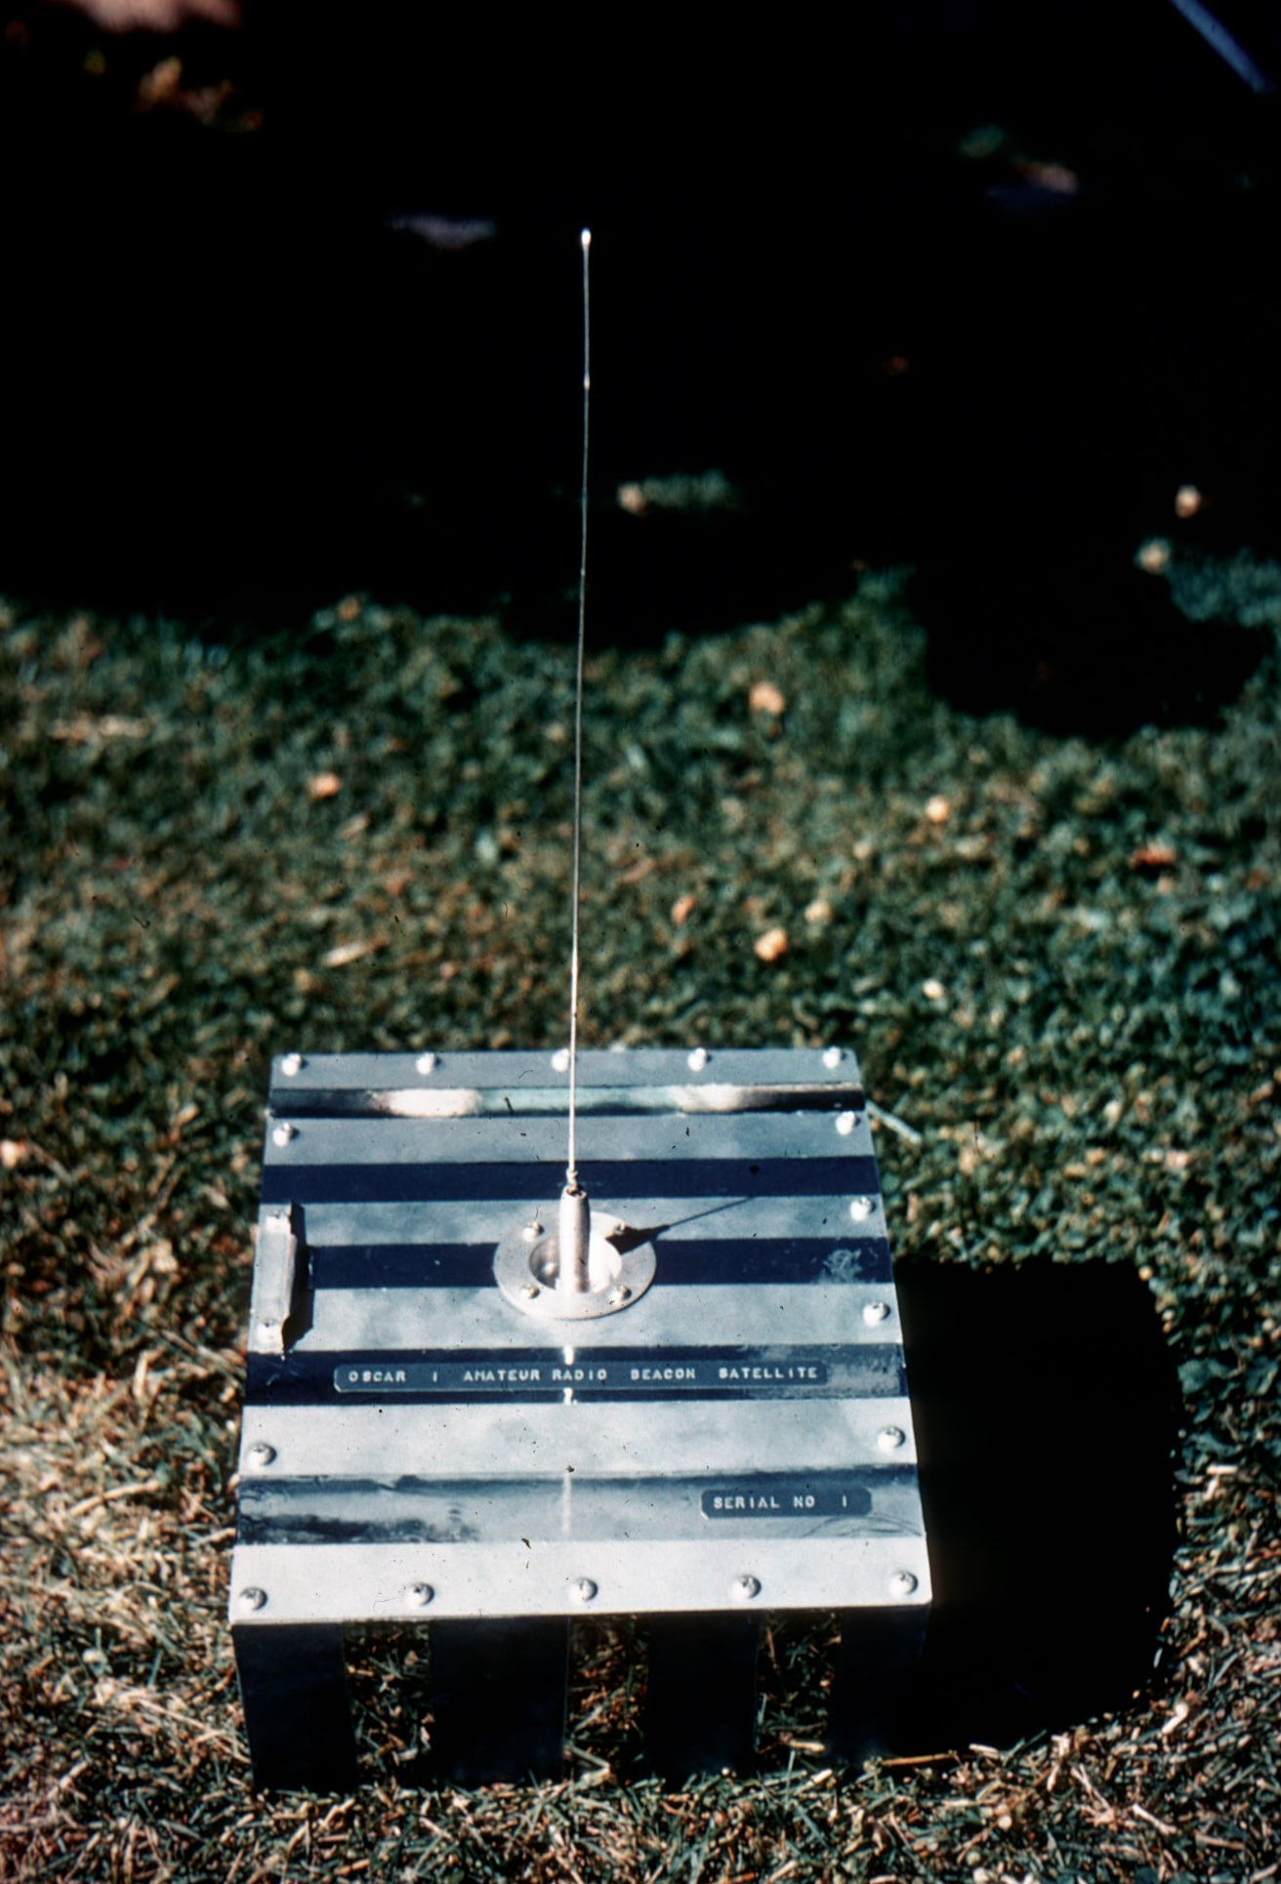
OSCAR-I Amateur Radio’s First Satellite
Soviet Union’s Sputnik launched on 4 OCT 57
Transmitted on 20.005 MHz
US launches Explorer-1 on 31 JAN 58
OSCAR Association is formed in 1960
OSCAR: Orbiting Satellite Carrying Amateur Radio
Consisted of amateurs who worked in the Defense Industry/TRW
Contacts within the US Air Force
OSCAR-1 is built and flown in less than two years
Launched on 12 DEC 61 from Vandenberg AFB
First “Secondary Payload” (Primary was a “Scientific Mission”)
Less than 10 lbs, battery powered/measured 9”x12”6”
Transmitted on 144.983 MHz with 140mW beacon transmitting “Hi” in CW
Apogee 430 km
Mission lasted 22 Days/de-orbited in 50 days

Slide 4
Lance Ginner, K6GSJ w/OSCAR-I

Slide 5
OSCAR-II
OSCAR-2 Launched 2 JUN 62
Structurally/electrically similar to OSCAR-1
Power reduced to 100mw to extend battery life
Modifications to thermal coating to cool the spacecraft
Modified the sensing system to measure accurately s/c temperatures as battery decayed
Apogee 390 km
19-day life/de-orbited
First US Government/Commercial Transponder
Telstar launched in 10 JUL 62 (highlighted by The Ventures)
TV, Telephone & Data
Huge Ground stations w/conical cone antenna: 177 ft. weighing 380 short tons (340,000 kg) housed in a 14 story radome

Slide 6
OSCAR-III Amateur Radio’s first “Transponder”
Launched 9 MAR 65 from Vandenberg AFB (Titan 3-C) with 940 km Apogee/70 deg. inclination
16.3 kg (30-lb.) Rectangular (20 x 30cm) spacecraft
Transponder: 50 KHz Wide, 1-watt transmitter
Received near 146 MHz/Transmitted near 144 MHz
Battery Powered Transponder/18-day life/remains in orbit
Battery/Solar Panels power beacons (145.85 + 145.95 MHz)
Technology Demonstrator
Transponder worked for 18 days/Beacons for several months
Demonstrated free access, multiple-access transponder amateur transponder could work in space
First long distance VHF contacts/1,000 hams from 22 countries
Identified need to use separate uplink/downlink bands

Slide 7
OSCAR-III

Slide 8
OSCAR-IV Dealing with Unexpected Consequences
Built by TRW Radio Club of Redondo Beach, CA
Project OSCAR crew was readying OSCAR III for flight
Designed for 21,000 mile circular orbit above the equator
Only 1-year to design/build/test/deliver
Minimal Design:
10KHz crossband transponder (2M uplink/70 CM downlink)
Transmitter output: 3 watts
Beacon for ID
Power: Solar Panels and Battery/1 year expected life
NO TELEMETRY
30 lb. satellite launched on 21 DEC 65 on Titan III-C
Upper stage of launch vehicle FAILS/Sat placed in “wrong” orbit
26° inclination/ apogee 21,000 miles/perigee 100 miles

Slide 9
OSCAR 4’s Tetrahedral Spaceframe

Slide 10
OSCAR-IV Dealing with Unexpected Consequences
Significant Challenges
Tracking (Limited resources to predict satellite position)
Doppler Shift due to orbital impacts (rapid relative movement to the earth). Doppler was greater than transponder bandwidth
Tumbling of spacecraft
Short Lifespan
85-day operation/de-orbited 12 APR 76
Probable battery failure/solar cell failure due to radiation
First Two-Way amateur satellite contact between US-USSR

Slide 11
OSCAR-5
Australian satellite built by University of Melbourne students
Started in late 1965
Design finalized in March 1966
Evaluate suitability of a 10 Meter downlink
Passive magnetic stabilization (reduce spin rate)
Uplink command capability /command receiver & decoder
Telemetry beacons at 144.040 MHz (50 mW) + 29.450 MHz (250 mW) w/7-channel analog telemetry system
Manganese-alkaline battery power supply
No transponder/solar cells

Slide 12
OSCAR-5
Despite administrative frustrations, satellite completed on 1 JUN 67 and delivered to Project OSCAR in California
Launch opportunity scheduled for early 1968
Host mission was delayed and indefinitely postponed
No other suitable launch could be identified
The satellite sits in a garage in California
Now What??

Slide 13
Birth of AMSAT
Members of DC Area Ham Clubs affiliated with :
Government Agencies
Communications Companies
Laboratories
met in late 1968 in the home of George Jacobs, W3ASK
Inspired by amateurs wishing to emulate Project OSCAR to Revitalize the Amateur Satellite Program
Radio Amateur Satellite Corp. was charted on 3 MAR 69 in the District of Columbia as a 501-(c)-(3) scientific & education organization
Connections with NASA provide an opportunity to find a launch following minor modifications to OSCAR-5

Slide 14
Australis OSCAR-5 Ready to Fly

Slide 15
OSCAR-5
Launched on 23 JAN 70/1480 km Apogee
Delta launch from Vandenberg AFB w/TIROS-M weather satellite
Outstanding results
Spin rate reduced by a factor of 40 (4 rpm to .4 rpm)
Command capability demonstrated (29 MHz beacon turned on/off on 28 JAN 70)
Ground station telemetry collection successful
With dying battery, 10 Meter beacon heard on day 46

Slide 16
Birth of the Amateur Satellite Service
ITU Convenes WARC-71 in June 1971
One Outcome is the birth of the Amateur Satellite Service
Separate entity from the Amateur Service in the International Radio Regulations
Formal Designation of bands for amateur satellites allowing future satellites to use more bands, including:
21.1-21.45 MHZ
28.0-29.7 MHz
435-438 MHz
In the US, an FCC license covers both the Amateur Service and Amateur Satellite Service

Slide 17
Next Generation: Phase II Satellites
Phase 1 Satellites
Featured short duration missions designed to gather information on basic satellite system performance
“Bleeding Technology” that attracted experimenters
During the 1970s, a new class of satellites were flown
Features included:
Wideband Two-way Communications Transponder
Relatively Long lifetimes
Telemetry
Ground Control of Spacecraft Functions with multinational Ground Station Command Stations
Solar Panels
Attracted satellite operators
By 1983, between 10,000 and 20,000 amateurs had worked Phase II

Slide 18
OSCAR-6 Design Philosophy
Built to operate for at least one year
Protect the investment in $$$ and sweat equity
Long lifetime could only be assured if a spacecraft contained
A sophisticated telemetry system that could monitor onboard systems
Flexible command system to turn on/off specific subsystems as conditions warrant
Redundant critical systems
A design strategy that anticipates possible failure modes, such as isolating and replacing defective subsystems
AO-6 was a quantum leap in amateur satellite design
35 different commands to control/manage the satellite
24 channels of telemetry with a special system to forward data to the ground using morse code using a digital number format

Slide 19
OSCAR-6
First satellite to use 2M uplink/10 meter downlink (100 KHz bandwidth)—now called “Mode A”.
435.1 MHz beacon and morse code telemetry system
21 Channel Command Decoder to control systems
Magnetic stabilization
First Digital Store-and-Forward System (Codestore) w/discrete logic and memory capacity of 256 characters (Records CW characters)

Slide 20
OSCAR-6
Prototype Transponder flown on a private aircraft to evaluate performance with real signals
“Contest” generated 66 logs
Thermal test of the flight transponder done in the kitchen oven of W4PUJ (“Burned the Cake”)
Launched on 15 OCT 72 with a weather satellite
900 Mile Apogee

Slide 21
OSCAR-6 Mounted on the Delta Launch Vehicle

Slide 22
OSCAR-6 “Works”
Static in the satellite affected the command system which read the noise as a command to shutdown
Command stations around the world send continuous stream of ON commands to keep AO-6 turned on
First audio tape loop audio and then digital logic
Automated processes developed to send commands
Over 80,000 commands sent per day in August 1973!
Solar-Charged batteries allowed the satellite to remain operational for 4.5 years
435 MHz beacon failed after three months/29 MHz provides the backup (“soft failure”)

Slide 23
OSCAR-6 Milestones
First “International” Satellite
Subsystems built by US, Australia, West Germany
Ground stations in Australia, Canada, Hungary, Morocco, New Zealand, West Germany, UK, US
Used by amateurs in over 100 countries
Educational Outreach
AMSAT and ARRL Collaboration
Space Science Involvement Manual released in 1974
Using Satellites in the Classroom: A Guide for Science Educators released in 1978

Slide 24
OSCAR-7

Slide 25
OSCAR-7
Launched on 17 NOV 74
Built in Jan King’s basement
1,460 KM Apogee
8.0 W output (vs. 1.5 W for AO-6)
Mode A (2M/10M)-built in the US
Mode J (2M/432 MHz)-built in W. Germany (DJ4ZC) with a HELAPS amplifier (High Efficiency Linear Amplification through Parametric Synthesis)
Beacons on 10M, 2 Meters, 70 CM, and S-Band (2304.1 MHz)
S-Band never used due to lack of FCC permission to operate it
Operating Life of “6.5 years” (1981)/returned to life in 2002

Slide 26
AO-7 Accomplishments
First Satellite-to-Satellite Communication Path
AO-6 and AO-7 in operation at the same time
Line-of-sight link-up using the 2M output signals from AO-7 to the input of AO-6 and retransmitted on 10 Meters (Mode A)
Linking later adapted by non-amateur spacecraft, including NASA’s Tracking and Data Relay Satellites (TDRS)
Location Experimentation
A ground station transmits a 2M signal to AO-6 and AO-7
Compute the location by comparing doppler shift
Technique eventually led to development of the Search And Rescue SATellite (SARSAT) Project to located downed aircraft and lost mariners
Accomplished BEFORE the advent of GPS

Slide 27
AO-7 Continues to Operate!

Slide 28
OSCAR-8 (“ARRL Satellite”)
ARRL funds AMSAT’s development of OSCAR-8 to provide a Phase II/Mode A satellite superior to AO-7 and to replace AO-6 ($50,000.00)
West Germany & Canada involvement
Carried 2M/70 CM transponder built by JAMSAT (“Mode J”)
Possible for uplink signals on 2M could be heard on both downlinks if battery levels could support both modes
Beacons on 29.402 MHz and 435.095 MHz
Launched 5 MAR 78 from Vandenberg AFB
910 KM/570-mile-high polar circular orbit
10 Meter antenna extended under ground command over the East Coast
Managed by ARRL Controllers for five years/worked until mid-1983

Slide 29
OSCAR-8 Testing

Slide 30
As the 1970s Close…
Russia develops two “RS” Amateur Satellites
“Radio Sputnik-1” and “Radio Sputnik-2” built by amateurs who had visited the US during the Apollo-Soyuz Program
Article published in October 1975 in Radio Magazine highlights Mode A developments in Moscow and Kiev along with the OSCAR program
Prototype transponder mounted on Moscow rooftop (1 W)
USSR notifies ITU in July 1977 that satellites in the Amateur Satellite Service would be launched
Both Satellites launched 26 OCT 78 on the same vehicle
Mode A with sensitive145 MHz receiver due to 5-Watt limitation for Russian ground stations

Slide 31
As the 1970s Close…
WARC-79 has impact on Amateur Satellite Service
Frequency assigned from 1 GHz-10 GHz
L-Band (1.5 GHZ uplink only)
S-Band (2.400-2.500 GHz uplink/downlink)
3.4-3.41 GHZ
5.83-5.85 GHz
10.45-10.50 GHz
Plus:
24.00-24.05 GHz
Provides the bandwidth that will be used on the Phase-3 Satellites
“Use It or Lose It” a concern

Slide 32
Phase 3 Satellites
Next Generation Satellites
Highly elliptical Molniya orbit with an apogee of several Earth radii
High inclination (64°) favors the Northern Hemisphere
Low Perigee (500 KM) allows orientation of the spacecraft w/on-board electromagnets
Long duration availability (8+ hours) as satellite approaches apogee
Large footprint (up to 40% of earth’s surface)/
Significant DX capability (equivalent to 20 Meter HF) using small antennas
Predictable long range communications
Large solar power systems
High power transmitters/directional antennas
Complex telemetry & control systems
Including commanding of propulsion (Kick motor)
Multi-Transponder operation
VHF/UHF
Microwave frequencies

Slide 33
Phase 3-A & Phase 3-B
Phase 3-A launched on 23 MAY 80
AMSAT raised ≈ $250K plus funds from AMSAT-DL
Placed on second launch of prototype ARIANE-3 vehicle @ Kourou
First stage fails in flight/Phase 3-A is placed in “subterranean orbit”
Major loss for AMSAT and the amateur radio community
Phase 3-B is Similar to Phase 3-A
Phase 3-A: 93 KG Launch Weight (1/2 of weight is the solid kick motor)
Phase 3-B: 130 KG (bi-propellant liquid 400 newton thrust motor)
50 Watt Mode B Transponder/152 KHz bandwidth
Beacons on 145.810/145.987 and 436.02/436.04 MHz
New: Mode-L (1269.45 MHz uplink/70 CM Downlink (800 KHz bandwidth)

Slide 34
Phase 3-B in Kourou

Slide 35
Phase 3-B International Effort
Satellite features international cooperation
A West German-lead project (Karl Meinzer, DJ4ZC & Jan King, W3GEY team leaders)
Subsystems from US, Canada, West Germany, Hungary, Japan
Built at GSFC Visitor Center by AMSAT w/paid staff and volunteers
First AMSAT project successfully launched outside the US
Phase 3-B launched from Kourou on 16 JUN 83
Successfully placed in orbit on Ariane L6 Mission
Once deployed, it was bumped by the launch vehicle
Damaged antennas and caused spinning
Initial burn lasted longer than planned/placed in a 50% higher orbit
Helium tank leak prevents second burn of kick motor
Designated AO-10
Suffers radiation effects/loses IHU in 1986 and eventually batteries

Slide 36
Phase 3-C

Slide 37
Phase 3-C
Utilizes same spaceframe as Phase 3-A/3-B
Built in Boulder, CO due to relocation of W3GEY
AMSAT-NA invests about $220,000.00
Harris Semiconductor donation of radiation hardened ICs
Systems added/modified:
Mode S Transponder (435 MHz uplink/2.4 GHz downlink)
Digital repeater: RUDAK (435 MHz uplink/146 MHz downlink)
Regenerativer Umsetzer fur Digital Amateur-Kommonikation (AX.25)
Modified Mode L Transponder adds 50 KHz wide 2-meter secondary input channel to the 250 KHz downlink (Mode JL)
Shipped to Marlburg, West Germany for balancing, vibration testing
Shipped to Kourou in late 1987

Slide 38
Phase 3-C becomes AO-13 Perhaps the most popular amateur satellite ever
Launched 15 JUN 88 from Kourou
Two successful burns of the kick motor
Demonstrated successful reorientation of spacecraft
Demonstrated successful spin-ups/spin-downs
Resulting orbital changes
36,265 km apogee/higher than expected perigee
Systems Performance
Mode B worked well/Less spin modulation/70 CM fails in June 1993
Mode L initially used 20% of time (>200 stations used it in first three months)
Mode S initial problems resolved
RUDAK failed due to low temperature sensitivity of a device
De-Orbited 5 DEC 96 due to influence of sun/moon/Earth

Slide 39
Phase 3-D

Slide 40
Phase 3-D Amateur Radio’s “Super-satellite”
Initial AMSAT-DL proposal made in 1985
Scaled-up version of Phase 3-C
5x the size and weight (400 kg)
Four deployable solar panels + two side mounted on the spaceframe
48 ft² surface area using solar cells with 14.3% efficiency=620 watts
3-axis stabilization using three magnetically suspended reaction wheels
Use amateur bands from 21 MHz to 24 GHz
In May 1990, International Team is Formed
AMSAT-DL received assurance of partial funding from the German Government
AMSAT-DL secures launch on second test flight of Ariane 5 (502)
Becomes AMSAT-NA’s most expensive program both in terms of $$$ and man-hours/more than all other programs combined

Slide 41
Phase 3-D Size Comparison

Slide 42
Phase 3-D Development “A Satellite for all Amateurs”
Components from 13 Countries
Russia Propellant Tanks
Japan SCOPE Cameras
United Kingdom 2M Transmitter/Auxiliary Batteries
Finland 10 GHz Transmitter
Czech Republic Receivers
USA Space Frame/GPS/RUDAK/Integration
Germany 70 CM Transmitter/LEILA/Project Management
(LEIstungsLimit Anzeige)-”Alligator Eater” IF Strip
Canada Radiation Testing
Belgium 146/435/2400 MHz Receivers
Hungary Battery Charger Regulators
Slovenia 21 MJz/5.7 GHZ Receivers
France 1.2 GHz Antenna/Test Support for SBS
New Zealand Machine Parts

Slide 43
Phase 3-D Development “A Satellite for all Amateurs”
Phase 3-D Integration Facility
Leased space secured in 1993 at the Orlando International Airport Foreign Trade Zone
Clean room constructed
Satellite integration starts in 1994
Weber State, UT builds the spaceframe/shipped to Orlando
Lou McFadin, W5DID becomes lab manager in 1996

Slide 44
Phase 3-D in the Orlando Clean Room

Slide 45
Phase 3-D Design Considerations: Ease of Use and Greater Flexibility
Transmitters will have significantly higher output powers
Antennas will have higher gain than on AO-10 and AO-13
Antennas will always point toward Earth
Requires the satellite to “know” its orientation with respect to space as well as to Earth using sun and Earth sensors
Re-orient the spacecraft using 3 magnetically suspended, orthogonally mounted reaction wheels coupled with three Nutation Dampers and two rings of electromagnets, the field of which can be stepped through six directions when operated in the Earth’s magnetic field
Adjust the pointing angle continuously to cause the antennas on the top of the spacecraft to point towards the center of the Earth
Thermal control system needed as spacecraft will not spin
Use four passive heat pipes filled with anhydrous ammonia mounted inside
Indirect re-radiation of the heat from internal equipment mounting panels to side panels that are deliberately allowed to become cold

Slide 46
Phase 3-D Orbit
Orbit: High Molynia 29,000 Miles x 2400 Miles/Orbital Period 16 Hours

Slide 47
RF Capabilities
Major Improvement in RF Capabilities using a 10.7 MHz IF Matrix with LEILA used on V-Band thru L-Band uplinks
Multiple options for combining of uplinks and downlinks
Receivers (Earth > Satellite)
21.210 - 21.250 MHz
24.920 - 24.960 MHz
145.800-145.990 MHz
435.300-435.800 MHz
1268.075-1268.575 MHz
1269.000-1269.250 MHz
2400.100-2446.700 MHz
2446.200-2446.700 MHz
5668.300-5668.800 MHz
Transmitters (Satellite > Earth)
145.805-145.990 MHz (≈250W PEP)
435.475-436.200 MHz (≈250W PEP)
2400.225-2400.950 MHz (≈250W PEP)
10.451025-10.451750 GHz (≈ 40W PEP)
24.048025-24.048750 GHz
Microwave Frequencies: “Use it or lose it”

Slide 48
A Challenging Development Program
AMSAT-NA raised $2 million (with help from ARRL)
Integration facility built in Orlando in 1994
Originally to fly on 2nd Ariane 5 (502) Test Launch in 1997
First Ariane V flight demonstrated higher than expected forces exerted on payloads
Phase 3-D required an upgrading of the spacecraft structure to meet new G-force requirements-delays completion
Development time also influenced by additional capabilities added to the spacecraft (“mission creep”)
Example: The addition of a Laser Communications Experiment
Extensive Testing
Thermal vacuum testing @ Orbital Sciences, Gaithersburg, MD
Vibration Testing @ GSFC, Greenbelt, MD

Slide 49
Phase 3-D mounted in the SBS

Slide 50
Fueling P3-D

Slide 51
Phase 3-D
Satellite delivered to Paris and then Kourou in February 2000
Weight @ Launch including fuel: 1,300 lbs
Width: 7.5 ft. Height 3.0 ft.
Solar Panel Wingspan: >20 ft./Cells produce 620 Watts
AMSAT also built the Specific Bearing Structure (SBS)
Houses P-3D and supports the primary payload (commercial satellite)
Offsets a portion of the launch costs
Launched on 26 NOV 00 on the 507 Ariane V launch
Initially placed in GTO and designated AO-40
Temporary, “self-cleaning” orbit
596 km perigee, 39413 km apogee, 6.5° inclination
Desired orbit ≈63° inclination, 48,000 apogee km, 4,000 km perigee

Slide 52
Kick Motor Burn
Same MBB engine used on AO-10 and AO-13 (400 N/95 lb thrust)
Bi-propellant: hydrazine (NMH) & nitrogen tetraxoxide (N2O4)
System is pressurized with helium
First attempt failed-sticking helium value suspected
Determined that fuel tanks could be properly pressurized by helium at a reduced helium flow rate over a five minute period, sufficient for 3-minute burn
Motor fires and signal is given to shut down at the 3-minute mark. Signal received by satellite and acknowledged but burn continues for three more minutes, causing a higher apogee

Slide 53
13 DEC 2000
While cycling the helium valve on 13 DEC 00, a sudden loss of all signals from AO-40 occurred.
Believed that during this exercise the system became pressurized and a leakage of fuel was the end result
Suspected damage to spacecraft structure as well as damage due to corrosive fuel entering the spacecraft interior
With the assistance of NORAD and Ken Hernandez, N2WWD the satellite was found and radar cross section analysis suggests the satellite is in one piece
News announced on 20 DEC 00

Slide 54
Disaster Recovery
Communications re-established on Christmas Day 2000 with second attempt to activate the S-band transmitter by an Australian ground station
Steps taken to regain control of spacecraft, including damage assessment, establishing proper spin and attitude control to allow proper power generation and antenna pointing
Root cause: Closed pressure relief opening of a valve on the 400-N motor. As a result, the remaining fuel stayed in the cooling chamber of the motor, and it is assumed, exited forcibly by a small explosion from a resulting leak.

Slide 55
Disaster Impact
Result:
Loss of V-band downlink
Loss of 70 cm downlink
Loss of omni antennas
What was working
S-2 downlink
2 L-band and 70 cm uplinks
1 W 24 GHz downlink
IHU/Power Systems/Magnetic Attitude Control
Apogee ended up being 57,000 km vice 36,000 km with low inclination

Slide 56
AO-40
General amateur use started on 5 May 2001
Satellite operates until 27 JAN 04 when main battery failure occurs
Lessons Learned:
Adding additional features has an exponential impact on spacecraft complexity
“Soft Failure” does provide a means to keep the mission alive
Kick Motor vs. ArcJet (used “cold” to make orbital adjustments)
Multiple uplinks/downlinks provides backup
Full and Complete Documentation/Procedures manuals are critical
Large projects can exceed the capability of a volunteer team
Missed deadlines/commitments
Organizational & Team burnout
All eggs in one basket
Cultural differences can impact team performance/results

Slide 57
Phase 3-D/AO-40’s Long Term Impact
AMSAT’s most expensive and time consuming project
While AMSAT-DL was the project leader, AMSAT-NA members viewed AMSAT-NA leadership as responsible
Impacts relationships
Different expectations on keeping donors/members informed
Loss of confidence in AMSAT’s Project Management
Need to revamp how projects are managed/documented
Lack of HEO satellites leaves members frustrated
Reduction in AMSAT membership
AO-40 issues forces AMSAT to start on new projects
AMSAT-DL decides on P3-E (“Express”) HEO project->Phase 5
AMSAT-NA decides on “Eagle” HEO project & Project Echo
Both HEO projects fail to fly due to unaffordable launch costs

Slide 58
In Summary…
Amateur Spacecraft development matures over 40 years
Size/Weight/ Complexity
RF options (bands/modes/power output)
Power Sources
Multiple Modes/capabilities
International cooperation to spread workload/fund raising and launch options
Most of the development work is in satellite support systems, not RF!
Cost of Development/Organizational limitations reached
Amateur Radio benefits from special relationships
Low cost or “free” launches
Agencies and Aerospace Companies willing to take risks
A number of “firsts” are accomplished

Slide 59
Building Satellites ‘on the Cheap’
AMSAT Depends primarily on volunteers
Only one full time employee (office manager)
KISS Approach to satellite design/”home brew”
Parts donation from corporate sources
Systems built in garages/basements
Develop university relationship (e.g. Weber State)

Slide 60
Launch Opportunity Strategy through the 1990s
Secondary Payload/Go when the primary is ready
Develop Innovative Designs to make available “unusable” space on launch vehicles
Example: 1990 launch of Microsats on Ariane IV
AMSAT will trade knowledge, Skill and Manufacturing capacity for a reduction/waiver of launch costs
Example: Specific Bearing Structure for P3-D on Ariane V
Take advantage of test launches w/inherent uncertainites
Example: Ariane III (Phase 3-A) and Ariane V (Ariane 502)
Launch Insurance NOT normally purchased
Cover risk by duplicating components, such as spaceframes

Slide 61
Microsats
AMSAT-NA develops a new design: “Microsat”
Genesis in a hotel room during 1987 AMSAT Space Symposium
9” x 9” x 9” Cube/ 20 lbs.
5 trays per satellite (“This Space for Rent” potential) “frame stack”
Store and Forward capability/Packet radio “PACSAT”
$50,000.00 allocated by AMSAT BoD to be completed in two years
Interest in the Design Spreads: 4 Satellites Total
Junior DeCastro, PY2BJO proposes “Dove”-voice messages
Weber State: Earth Viewing Camera Satellite
AMSAT-LU asks to be included for PACSAT support in South America
Common Structure/Basic Utilities Incorporated
Integration takes place at a leased office space in Boulder, CO
Modules developed in batches of four & shipped to Boulder
Satellites completed in Fall 1989

Slide 62
Microsat Design Philosophy
Eliminate wiring harnesses whenever possible
Create a mechanical structure that could be completely assembled/disassembled < 30 minutes
Create a solar array design that minimizes the possibility of damage yet can be rapidly installed on the spacecraft body
Use load-side power management to dynamically adjust the transmitter’s power output to maintain an orbit-average balance
Create a microsat design that can serve users employing omni-directional antennas
Develop a suitable computer w/serial data comms over multiple channels, store at least 4MB of data, uses <1 Watt
Aim for spacecraft mass of 10 kg

Slide 63
Microsats
University of Surrey secures launches for the Microsats and two UoSats (UoSat-OSCAR 14, UoSat-OSCAR 15)
Housed on the “Ariane Structure for Auxiliary Payloads”
(ASAP)
Launched on 22 JAN 90 on ARIANE 4
PACSAT (AO-16): 2M/70 CM + S-Band downlink on discrete frequencies
DOVE (DO-17): 2M + S-Band Downlink only (recorded messages)
WeberSat (WO-18): 2M/70CM Downlink 4 W (images)
Weberware ground station software to view images
L-Band ATV uplink
LUSat (LO-19): 2M/70 CM 4W + .8 Watt output on discrete frequencies
805 km circular Sun-synchronous orbit

Slide 64
All 4 Microsats and 2nd Gen UoSats on First Ariane-4 ASAP Ring

Slide 65
Microsat Design Impacts
Microsat Design Generates Significant Interest
IO-26 built by AMSAT-Italy included 9600 baud capability
Limited amateur radio use
AO-27 is a payload built by AMRAD as part of Interferometics EYESAT commercial satellite
FM repeater “EasySat”
Launched 26 SEP 93 (same launch as IO-26)
SpaceQuest builds microsats for government & industry
MO-30 built by students/staff of Autonomous University of Mexico
Identical to UNAMSAT-1 destroyed by launch vehicle failure on 28 MAR 95
Included a 70 W peak power radar transmitter @ 40.997 MHz to monitor micrometeorite impacts in the upper atmosphere
Receiver failed shortly after placement in orbit on 5 SEP 96
AO-51 built by SpaceQuest under AMSAT contract
Launched 28 JUN 04 from Baikonour Cosmodrome (Dnepr launch)
4x capability of original microsat design

Slide 66
Project Echo Flies to Moscow

Slide 67
Microsat Design Impacts
Design demonstrates utility for small satellites
Impacts launch opportunities and launch costs
As electronics improve, more can be done with same footprint
Standardized design/footprint reduces costs
First AMSAT satellites that could be built “cookie cutter”
Initiates greater interest in “smallsats”
AMSAT becomes “victim of our own success”
University, Industry and Government interested in smallsats
Closes the door on AMSAT taking advantage of “unused space” on launches
Forces real $$$ to be spent on launches

Slide 68
Why did AMSAT Build ARISSat-1?
Educational Outreach
One of AMSAT’s key mission statements (“Promote space education”)
Provide a vehicle for student experiments
Provide telemetry for student analysis
Provide ‘student messages’ in various languages for students to receive
An opportunity for students to learn about satellites and orbital tracking in the classroom and then listen for ARISSat-1 using basic equipment
Video (SSTV)
In exchange for educational outreach:
‘Free Launch’ of amateur radio capability
A platform for technology development (SDX)
Potential for recurring opportunities

Slide 69
Satellite Purpose: Technology Demonstrator
Communications Technology Platform: Testbed for SDX
4 different carrier frequencies transmitted simultaneously
Different transmission modes (CW, FM, Digital Data, Transponder)
First amateur radio satellite to have both its receiver and transmitter (“transponder”) operate as software defined units
Power Management Technology Platform: MPPT
Maximum Power Point Trackers are dc-to-dc power converters
Designed to maximize power provided by solar panels (19 watts of power from each panel) independently of ground control’
Each solar panel had a MPPT attached to it
Use of commercial off-the-shelf video cameras provided SSTV imagery

Slide 70
The ARISSat-1 SDX Band Plan
CW 25 mW BPSK 100 mW Transponder 125 mW FM/SSTV 250 mW

Slide 71
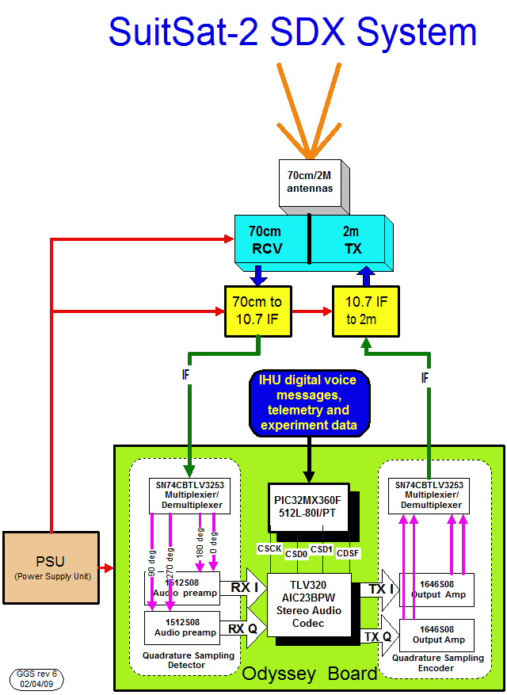
Software Defined Transponder SDX
Not a “Bent Pipe” Transponder

Slide 72
Satellite Purpose: Technology Demonstrator
Demonstration of a new Data Communications Protocol
BPSK-1000 protocol developed by Phil Karn, KA9Q
Designed to allow a significant amount of data (satellite telemetry and student experiment data) despite signal nulls and fading
Significant performance improvement over earlier protocols
Amateur Radio Transponder
70CM uplink/Two meter downlink w/16 KHz wide bandwidth
Four independent sets of conversations at one time
CW (“Morse Code”) Reception
Transmission of amateur radio callsigns of key individuals who made contributions to amateur radio in space
Focus on “trying CW”
Served as “relative tuning indicator” as well as to indicate which telemetry downlink was in operation (BPSK-1000 vs. BPSK-400)

Slide 73
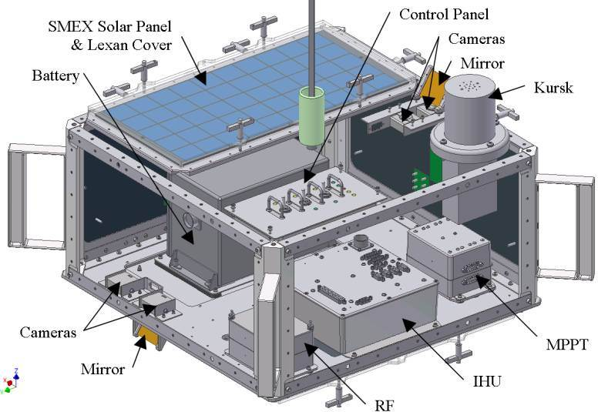
ARISSat-1 Hardware

Slide 74
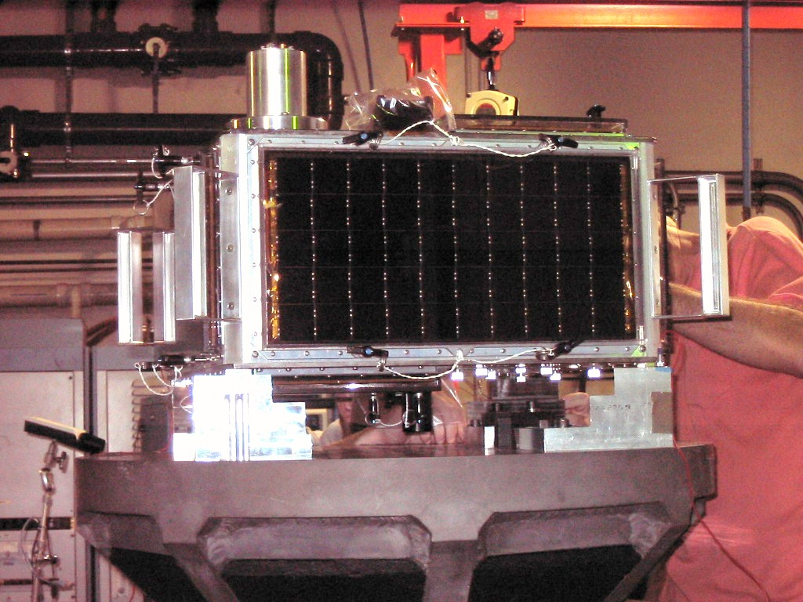
Vibration Testing

Slide 75
ARISSat-1
Deployed from ISS on 3 AUG 11
De-orbited on 4 JAN 12
Prototype satellite for supporting student experiments
Prototype for Ground station telemetry and payload data collection
SDX proven to be very successful. Expect future satellites (Fox-2) to use this technology
Education Outreach Lessons Learned
Critical that AMSAT maintain commitments to Partners
First AMSAT-NA satellite placed in service since AO-51

Slide 76
CubeSats
Further miniaturization of spacecraft
Initial design created by CalPoly in 2003, including a “Pod” to house/deploy the sats on a launch vehicle
10 cm x 10 cm x 10 cm (4” x 4” x 4”)
1 KG mass (about 2.2. lbs.)
Designed for universities
Offer spacecraft design/construction/project management courses for students
Relatively low cost to fly (low mass/size)
Offers potential for university scientific payloads
Standardized footprint/small size reduces launch costs
Can be expanded in multiple units (e.g. 2U, 3U, 6U, etc.)

Slide 77
AMSAT in a New Environment
Launch costs continue to Rise/”No Free Launch”
Supply & Demand + ability of firms with “real $$$” drive launch fees
$10 million for a Phase-3 HEO project
$10 million for a payload placed on a Geosynchronous Satellite
$1 million to deploy an ARISSat-x from the ISS
$500K to launch a Microsat into LEO
$300K to launch a 3U CubeSat to LEO
$100,000 to launch a 1U cubesat into LEO

Slide 78
AMSAT in a New Environment
ITAR prevents AMSAT from collaborating with International Partners
“Deemed Exports” refers to any technical exchange with foreign nationals
Can occur anywhere (e.g. in the US)
E-mail exchanges, telcons, face-to-face meetings, etc.
Voluntary self-disclosure in February 2009 on P3-E involvement to DDTC
DDTC Denied ITAR exemption for P3-E Subsystem Development in late 2009
CAN-Bus
Software Defined Transponder (SDX)
Internal Housekeeping Unit (IHU)
Mechanical/Thermal Design Analysis

Slide 79
AMSAT in a New Environment
Any Future Satellite Program would be “AMSAT-NA” Only
Satellite building is the essence of AMSAT
Membership support for AMSAT predicated on projects
Need to rebound from HEO Satellite disappointments
Must be a self-contained program due to ITAR that essentially prohibits technical collaboration with foreign nationals
Must be affordable based upon expected ability to raise funds with the membership or from the amateur radio community
Must be a project that is manageable with realistic deadlines

Slide 80
AMSAT’s Strategic Direction
In 2009, the AMSAT BoD realized:
Satellite builders were retiring/AMSAT Engineering needed to be reseeded
Launch costs for even a Microsat were beyond AMSAT’s current means
AO-51 was suffering degrading performance and needed to be replaced
Technology improvements would allow a cubesat to work as well as a FM repeater satellite as AO-51 from a ground user’s perspective
Decision made that a CubeSat would be AMSAT’s next project
Manageable project filling a critical need (replace AO-51) where new project management processes would be instituted
A basis for rebuilding the AMSAT Engineering Team
NASA ELaNa program potentially offered potential grant to fly a cubesat
A dependable CubeSat RF design to support scientific experiments would be of interest to universities & provide launch opportunities
“An OSCAR in every CubeSat”

Slide 81
Partnerships Opens the Door for Launches
Partner with Universities to provide the justification for someone else to pay for a Launch
ELaNa based on scientific research that matches NASA goals
AMSAT raises funds to pay for spacecraft development
Education Outreach in support of STEM can provide outside support
ARISSat-1 had an educational component
Student projects on AMSAT Spacecraft (such as Fox-1A)
Penn State-Erie MEMS (Micro-Electro-Mechanical Systems) Attitude Experiment
Challenge is to build an educational package that is attractive to schools/teacher
FUNCube-1 has a science experiment for Middle School
Downside: Launch opportunities may be 3-5 years after program acceptance

Slide 82
The Future is Relatively Bright for Keeping Amateur Radio in Space
Fox-1A will be completed this year/flown in 2015
Successful flight will improve chances for having more cubesats supporting amateur radio
Engineering experience rebuilds AMSAT Engineering
Lessons learned will be applied to Fox-2
Software Defined Transponder was first flown on ARISSat-1
Larger spacecraft offers more power generation/antenna real estate
Established University relationships set the tone for networking for payloads that justifies future launch support
Virginia Tech
Vanderbilt
Never say Never Concerning Future HEO projects
Is there a scientific payload that will justify a HEO mission?

